Slide 1
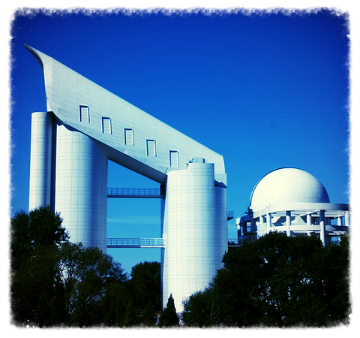
太阳与恒星
Yang Huang (黄样)
SWIFAR, YNU
(云南大学中国西南天文研究所)
https://yanghuang0.wixsite.com/yangh
银河下的郭守敬望远镜 (LAMOST) — 摄影苏晨

Slide 2
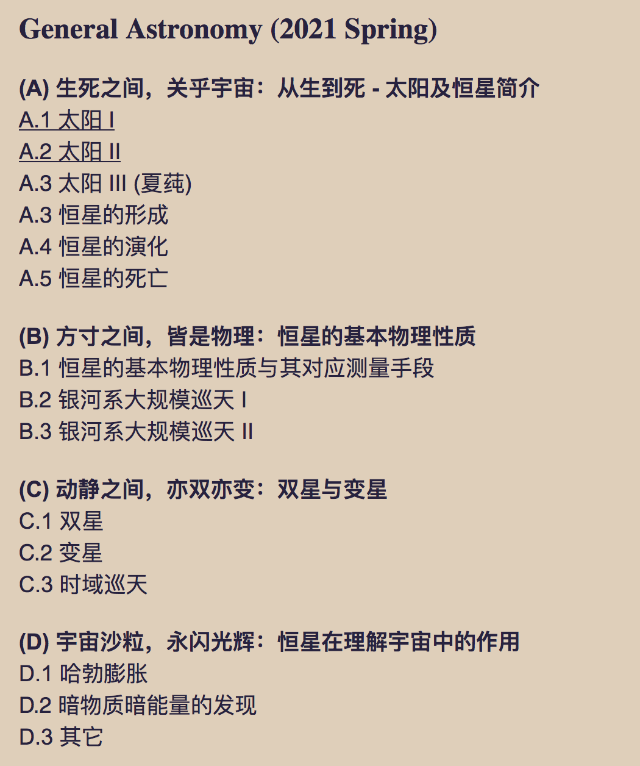
Outline (课程设计)

Slide 3
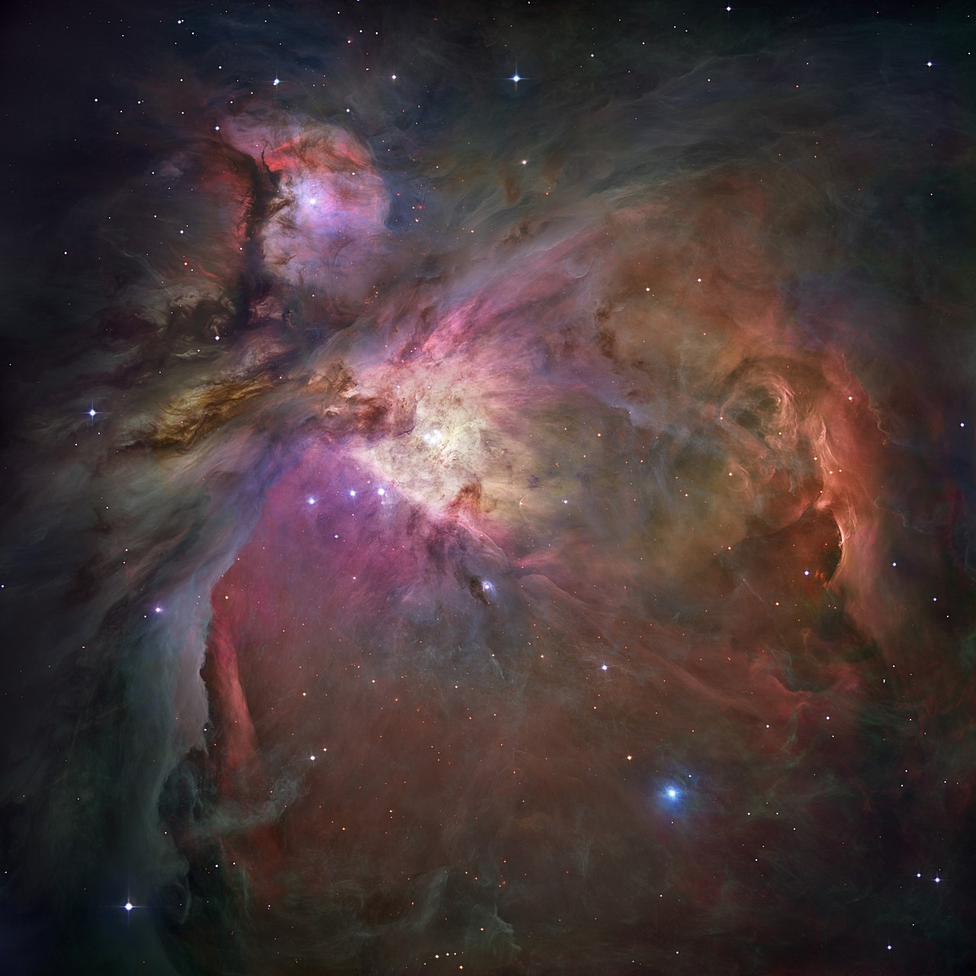
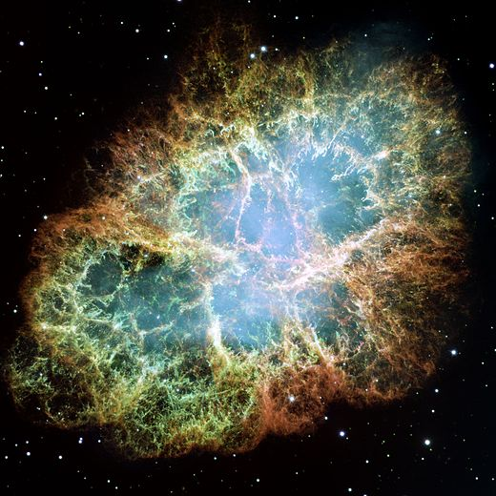
A brief introduction of star
从生到死，恒星简介

Slide 4
A brief introduction of star
从生到死，恒星简介
生如夏花之绚烂，死亦如夏花之绚烂！

Slide 5
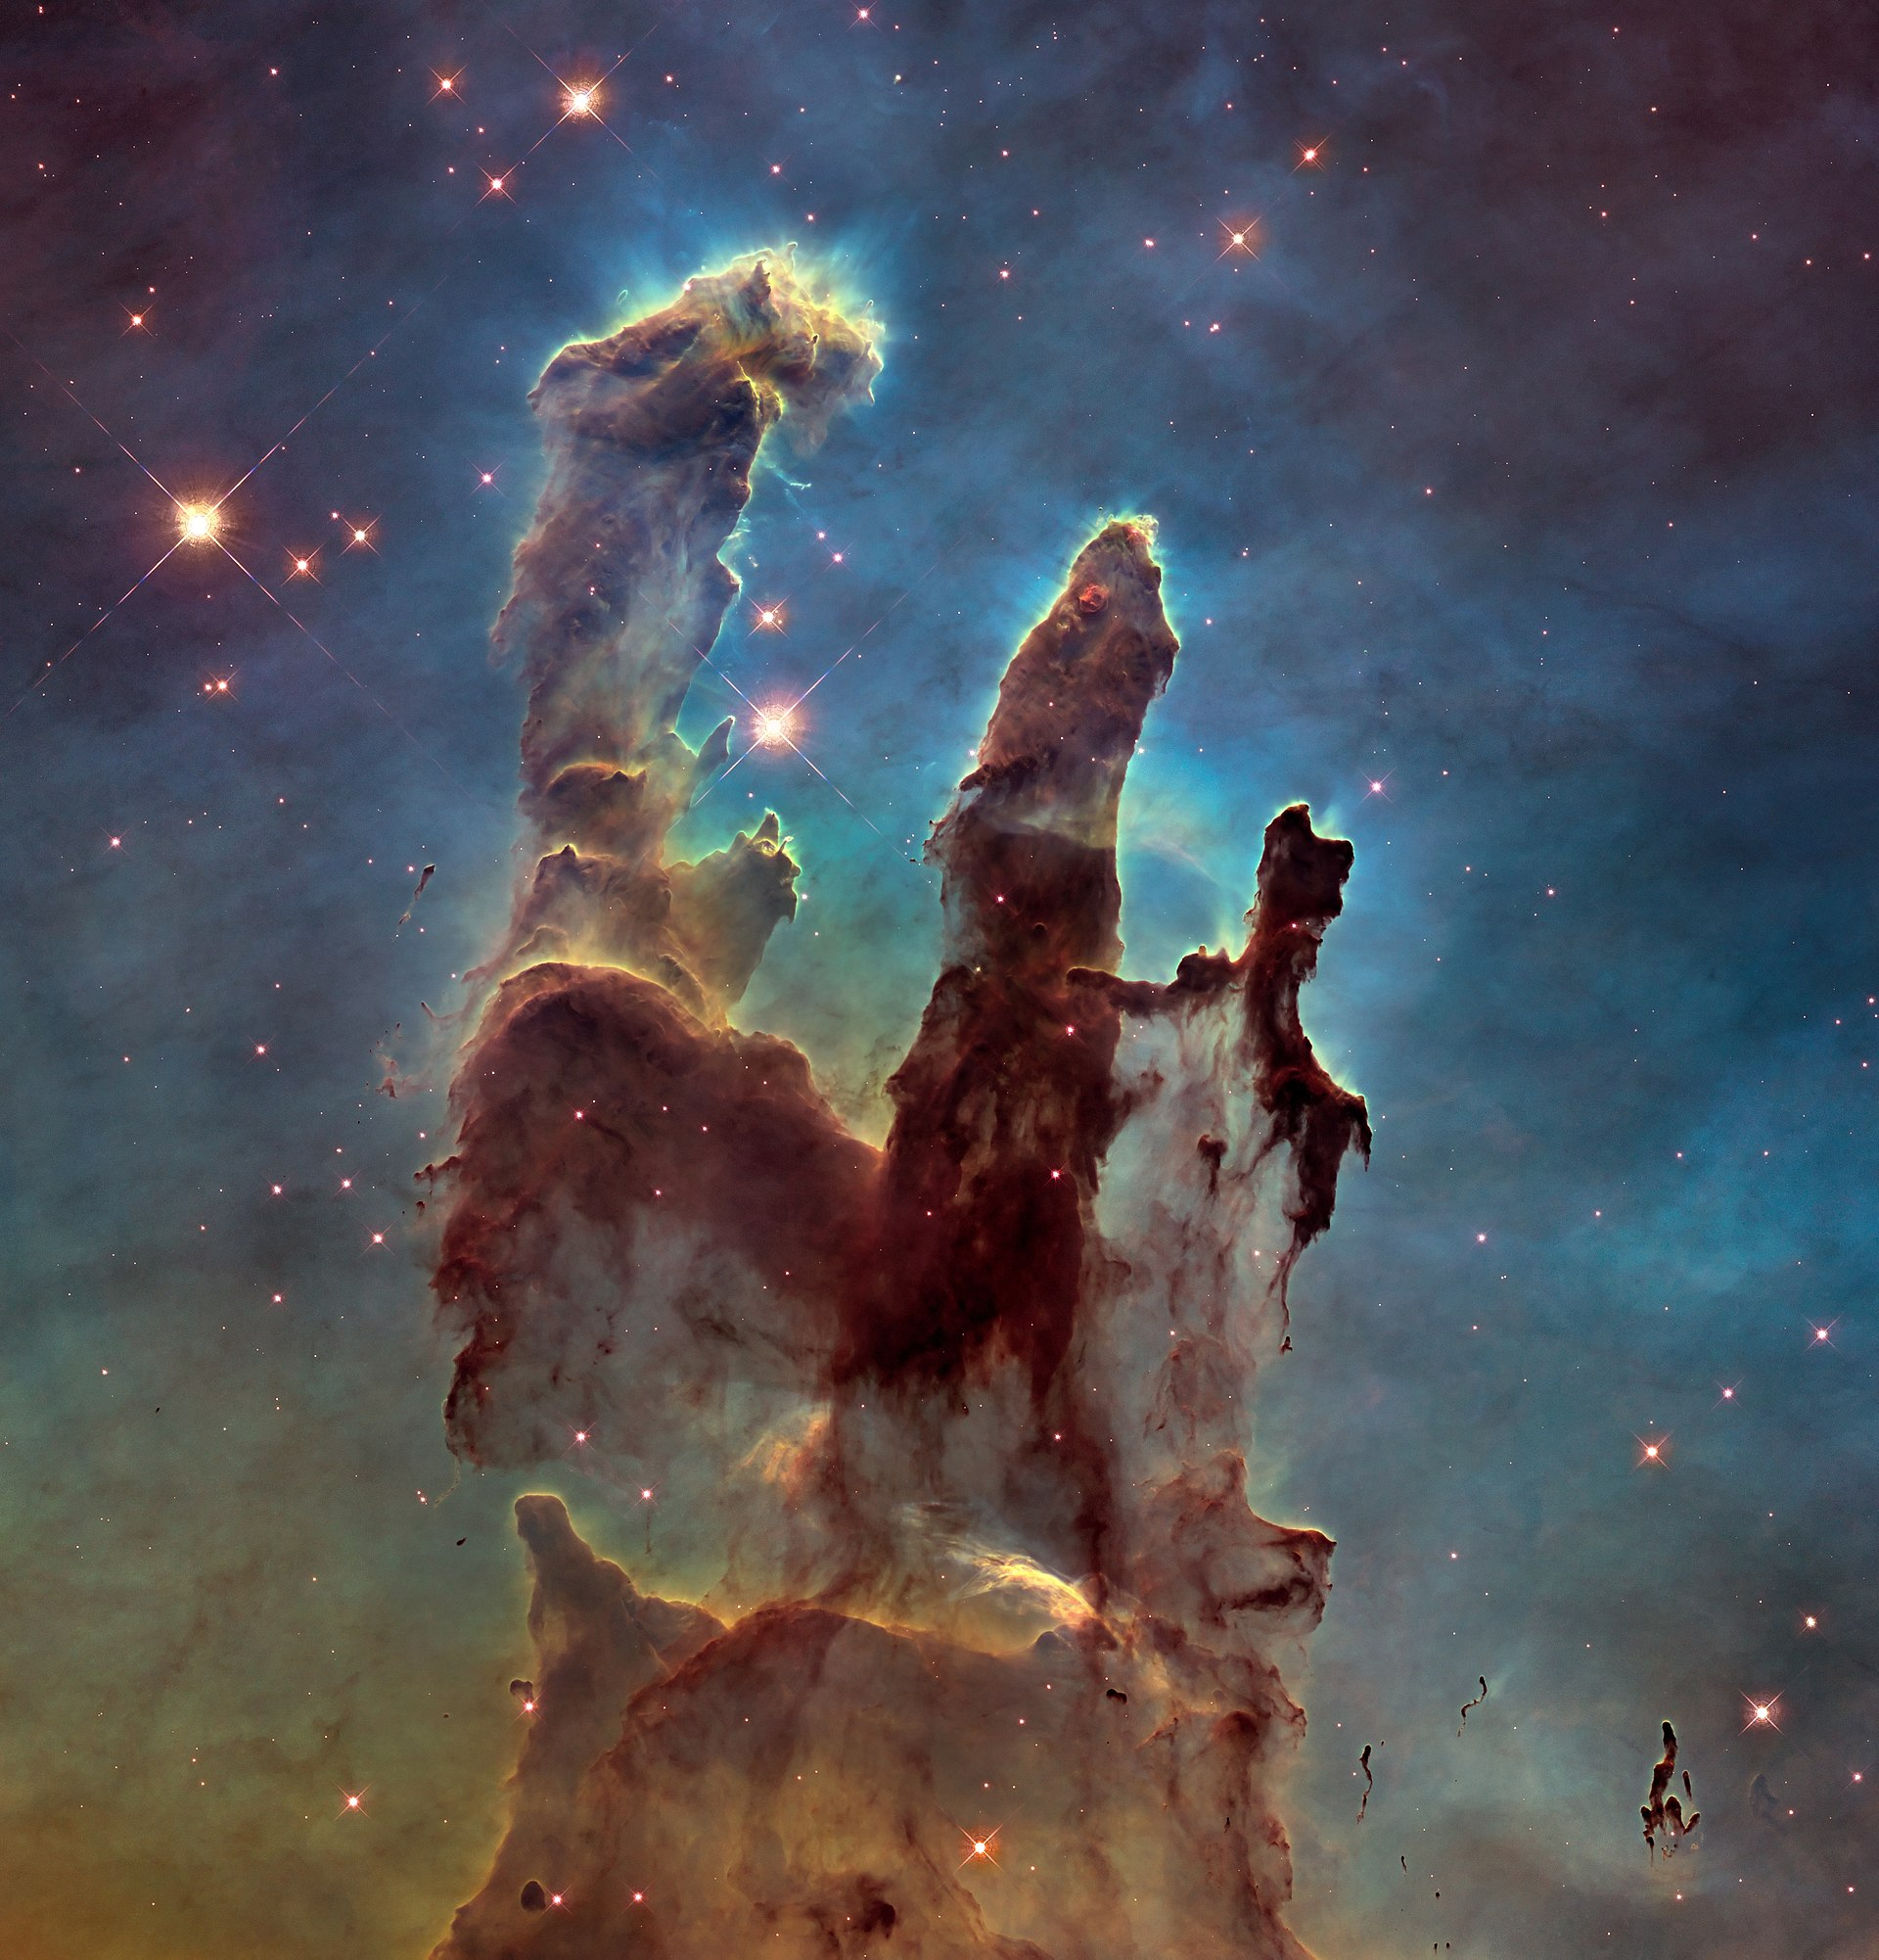
The birth of star
恒星的诞生
“Pillars of Creation”
创世之柱
Stars are born in molecular clouds：
Consist of molecular hydrogen (H₂) gas and dust grains (10⁻²⁴ g/cm³)
Masses of 10⁵ to 10⁶ solar mass
Sizes of ~150 light years in diameter
所有的恒星均诞生于分子云：
由分子氢和尘埃颗粒组成 （ 10⁻²⁴ g/cm³；星系际介质 ）
质量约为10⁵ 到 10⁶太阳质量
尺寸约为150光年（直径）

Slide 6
The birth of star
恒星的诞生
“Pillars of Creation”
创世之柱
Stars are born in molecular clouds：
Consist of molecular hydrogen (H₂) gas and dust grains (10⁻²⁴ g/cm³)
Masses of 10⁵ to 10⁶ solar mass
Sizes of ~150 light years in diameter
所有的恒星均诞生于分子云：
由分子氢和尘埃颗粒组成 （ 10⁻²⁴ g/cm³；星系际介质 ）
质量约为10⁵ 到 10⁶太阳质量
尺寸约为150光年（直径）

Slide 7
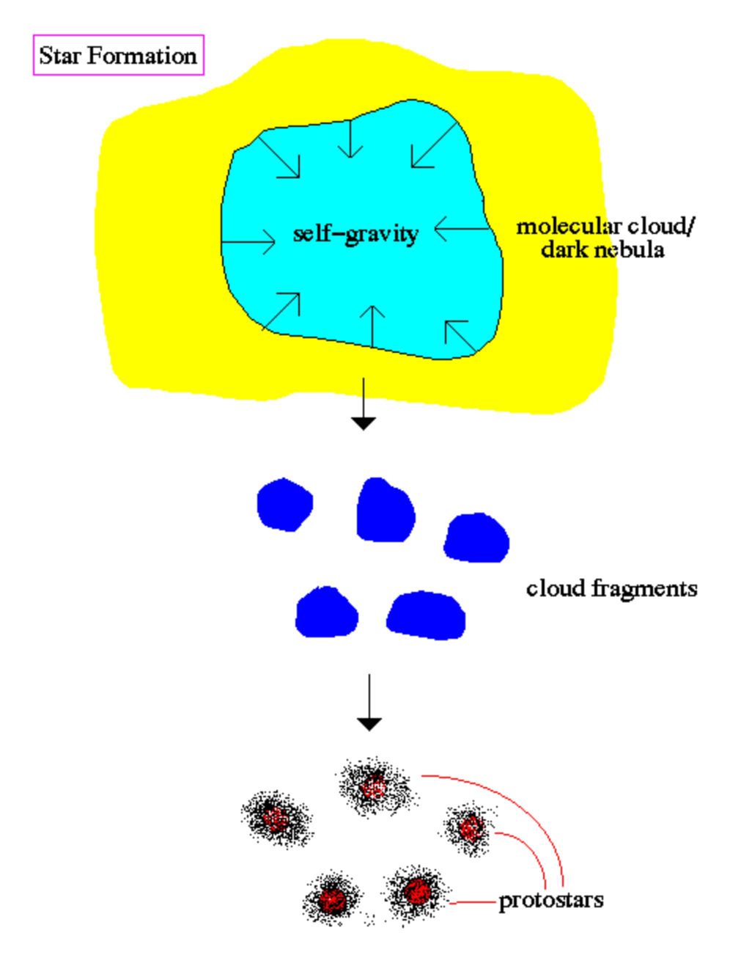
The birth of star
恒星的诞生

Slide 8
The birth of star
恒星的诞生
L

Slide 9
The birth of star
恒星的诞生
金斯长度和金斯质量：
金斯长度 𝛌_{J} = (𝛑v_{s}²/G𝛒)^{1/2}; 金斯质量 M_{J} ∝ 𝛒 𝛌_{J} ³ ∝ 𝛒^{-1/2}
当气体的质量M > M_{J}或尺寸𝛌 > 𝛌_{J}时，就会出现引力不稳定性，气体由此而塌缩。这个结论称为金斯判据。

Slide 10
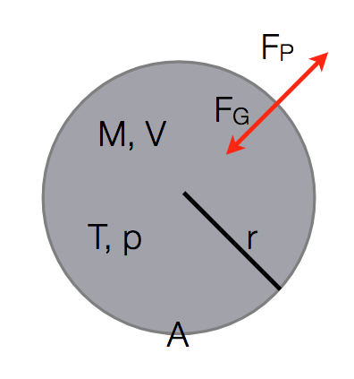
The birth of star
恒星的诞生
金斯长度和金斯质量：
我们用量级估计的方法来理解并尝试推倒金斯判据：
压力/热
引力/引力能
理想气体状态方程

Slide 11
The birth of star
恒星的诞生
金斯长度和金斯质量：
我们用量级估计的方法来理解并尝试推倒金斯判据：
fg = Fg/V = GM^2/L^2/V
fp = Fp/AL = nKT/L
M = Nm; n = N/V

Slide 12
The birth of star
恒星的诞生
金斯长度和金斯质量：
L ~ (kT/G𝛒m)^0.5
M ~ 𝛒L^3 ~ T^(3/2) 𝛒^(-0.5)

Slide 13
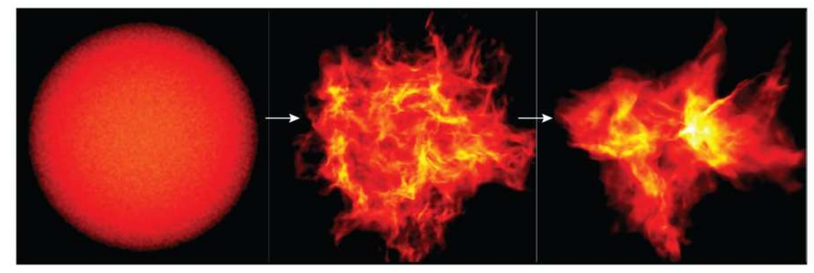
The birth of star
恒星的诞生

Slide 14
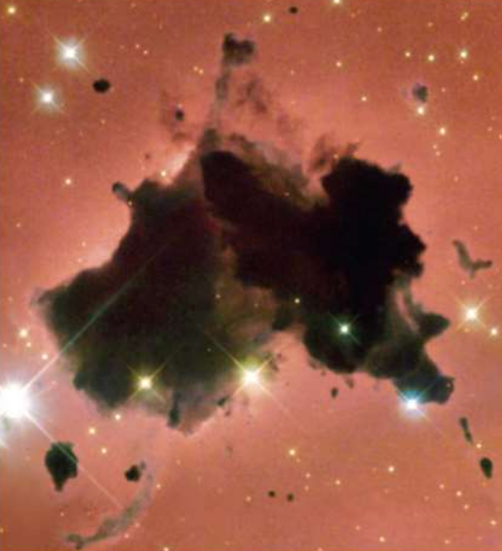
The birth of star
恒星的诞生

Slide 15
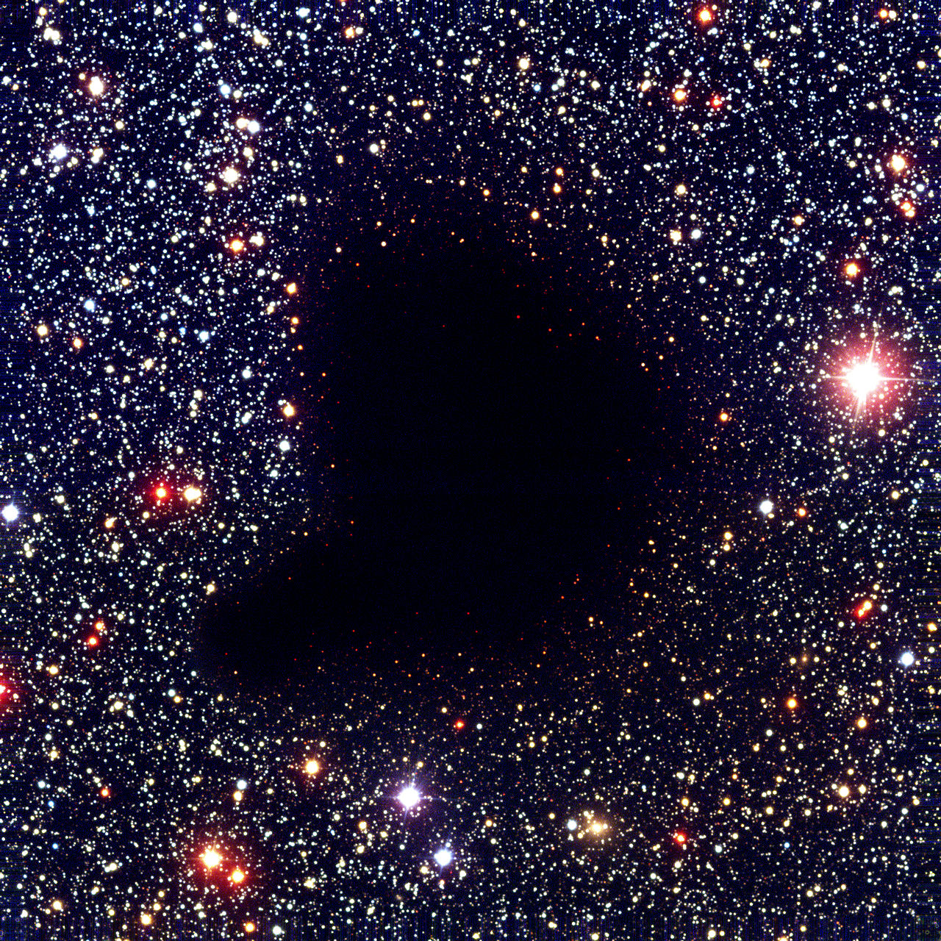
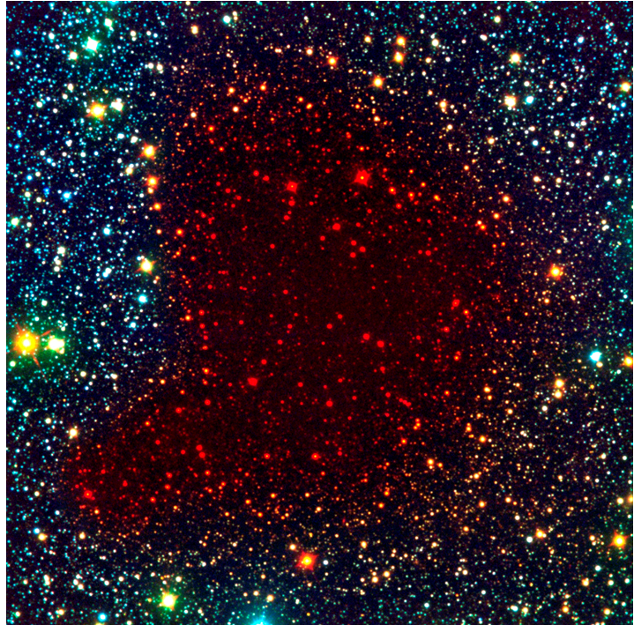
The birth of star
恒星的诞生
Bok globule
Bok globule

Slide 16
The birth of star
恒星的诞生
大质量恒星形成之谜
塌缩力：
引力
抵抗力：
气体压力
湍流
磁场
径向辐射压

Slide 17
The birth of star
恒星的诞生

Slide 18
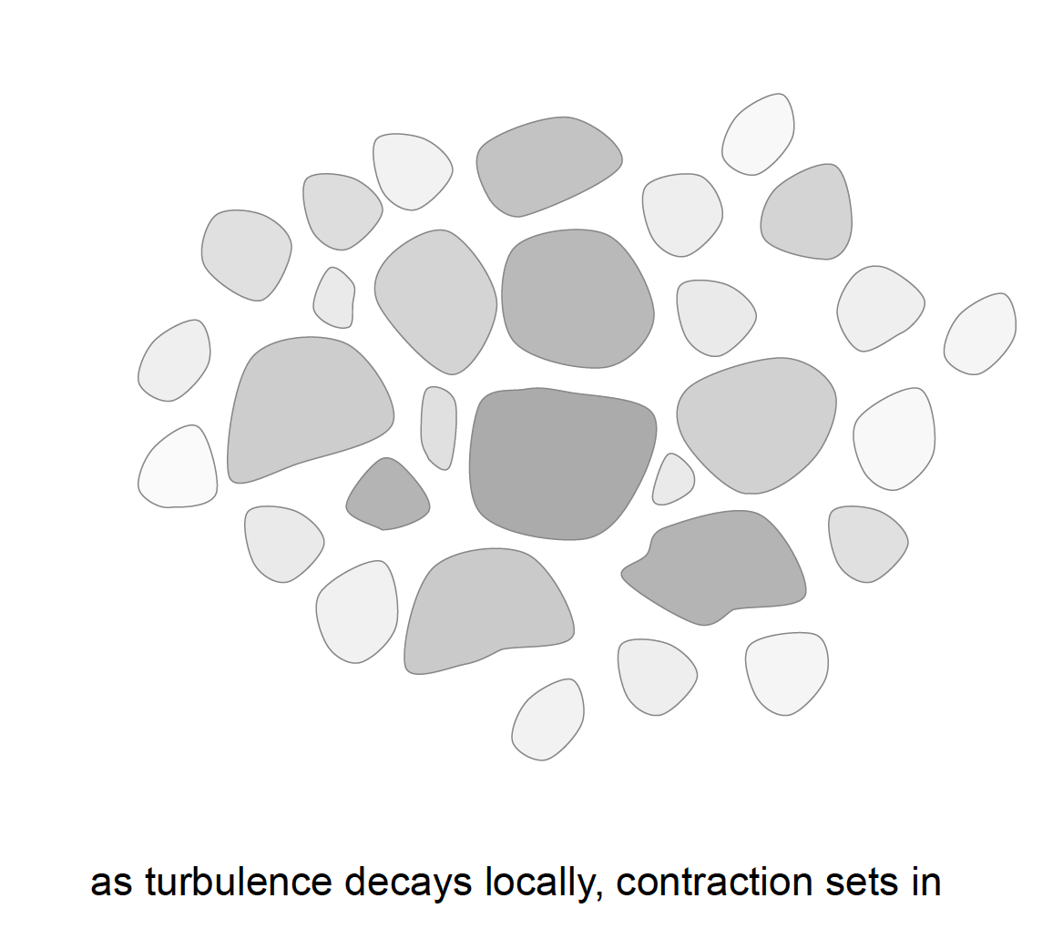
The birth of star
恒星的诞生

Slide 19
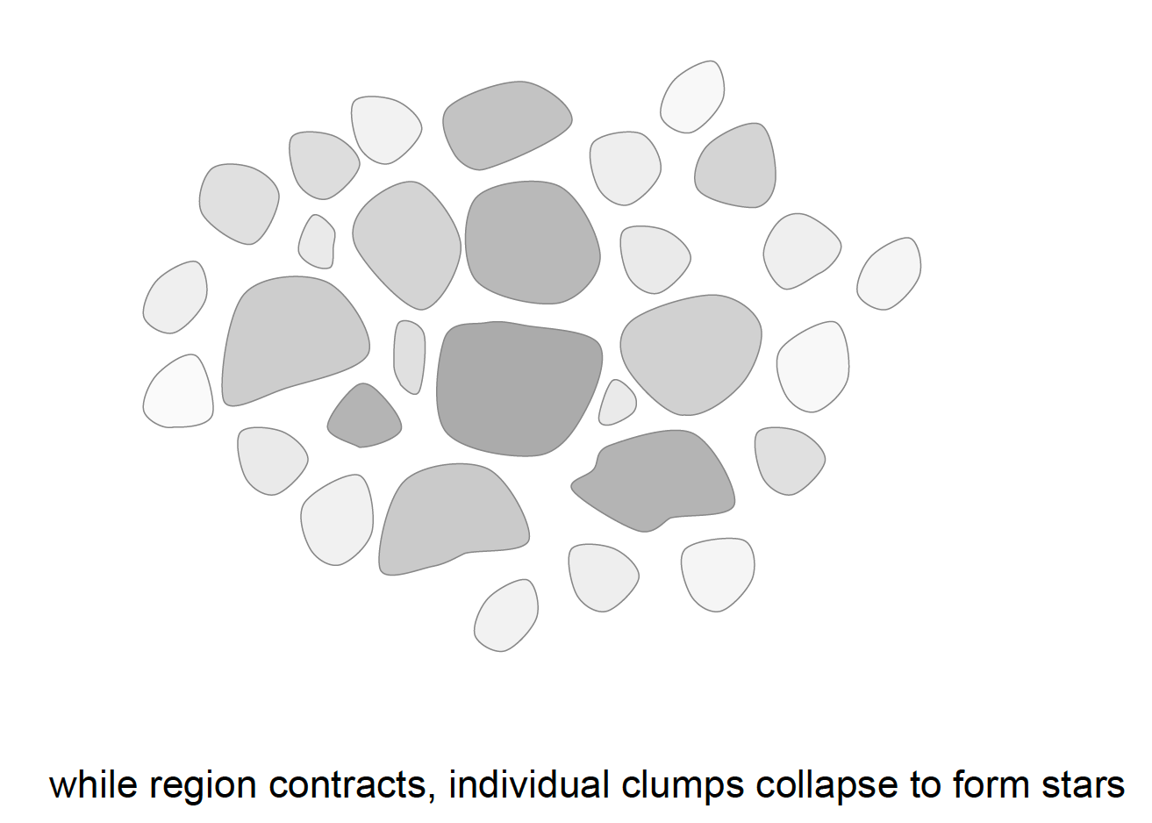
The birth of star
恒星的诞生

Slide 20
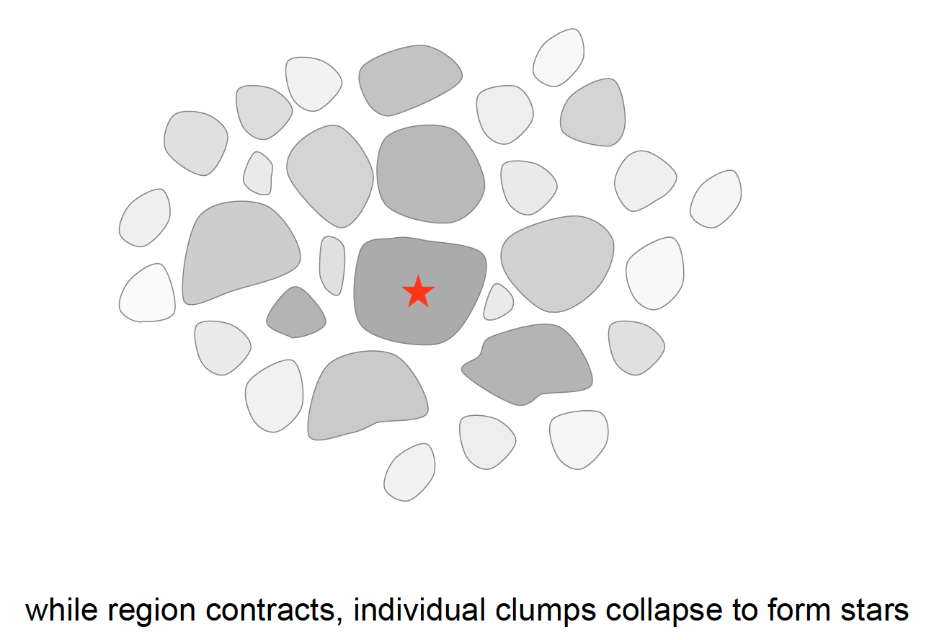
The birth of star
恒星的诞生

Slide 21
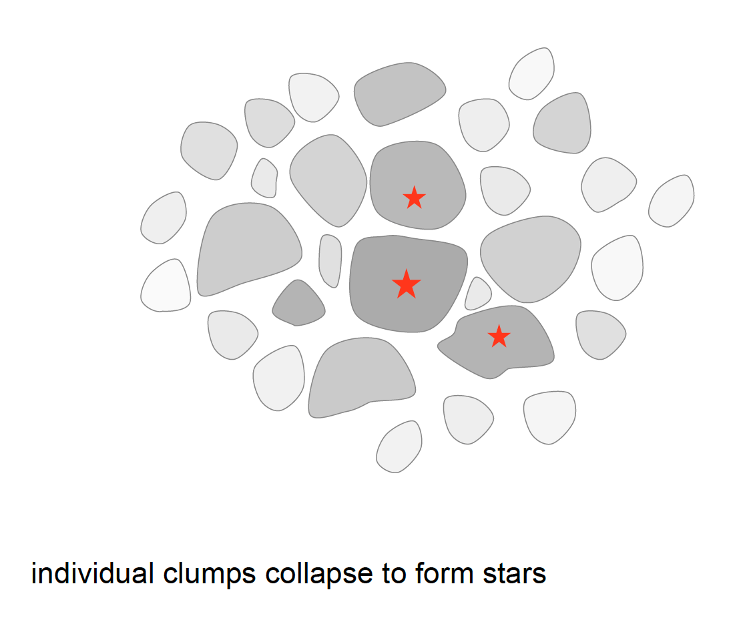
The birth of star
恒星的诞生

Slide 22
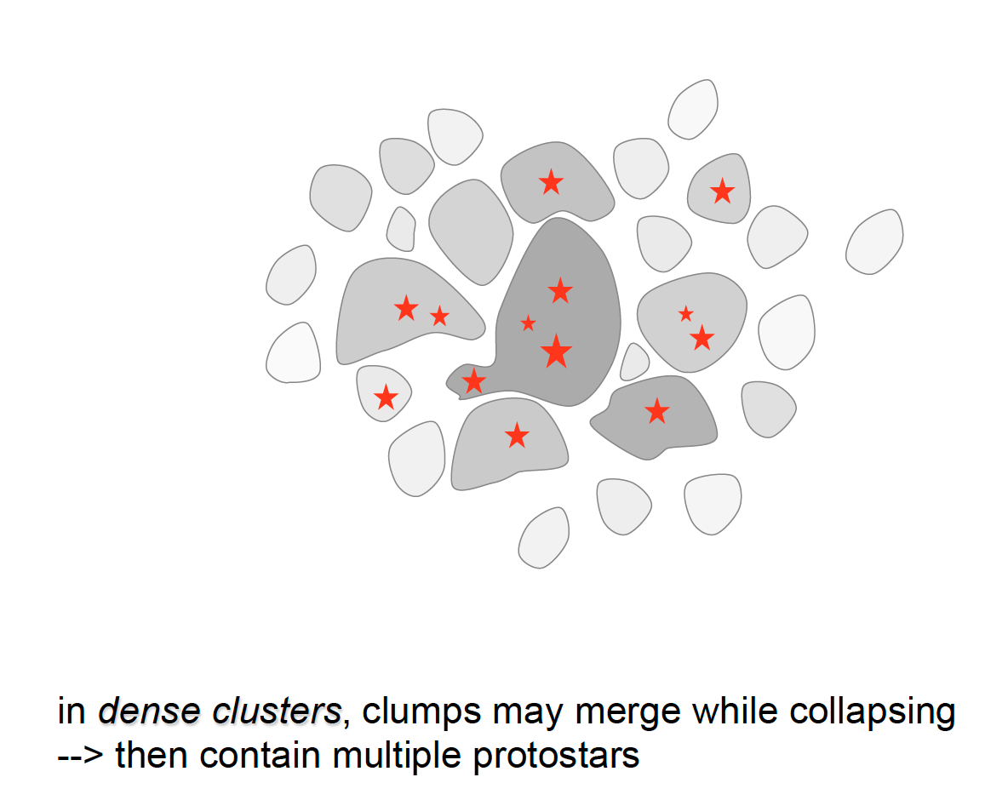
The birth of star
恒星的诞生

Slide 23
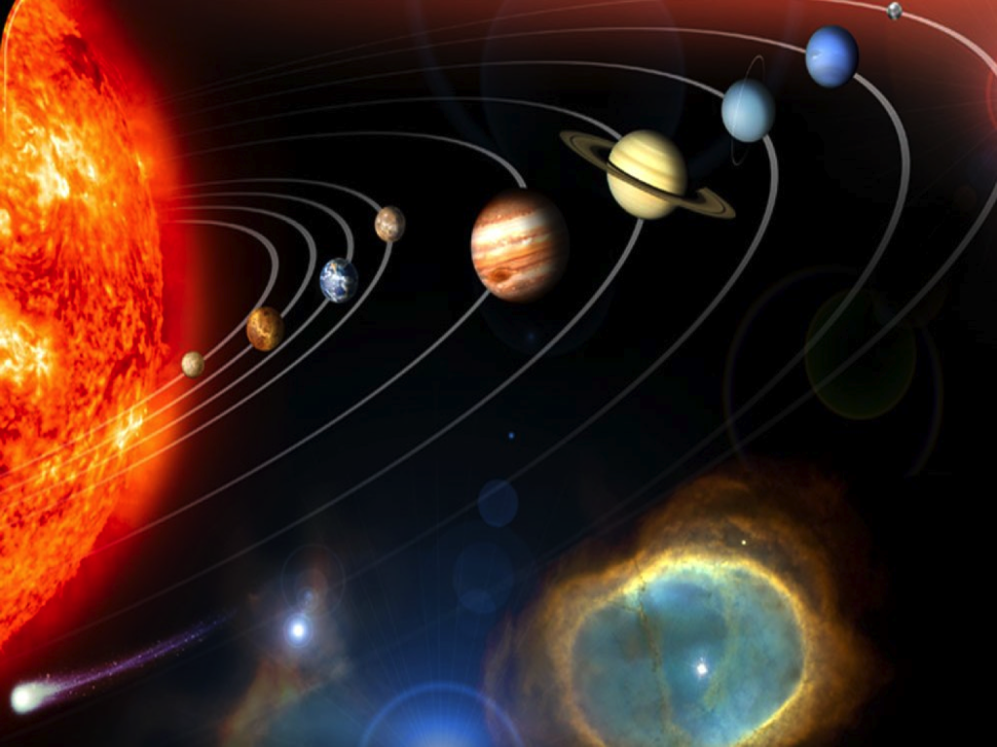
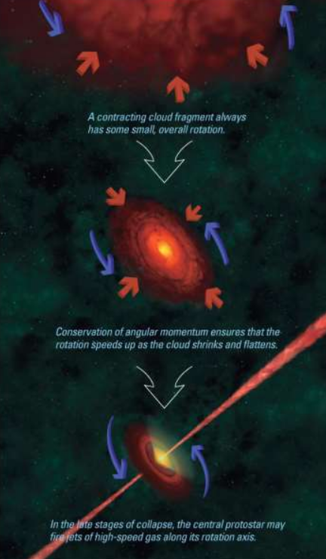
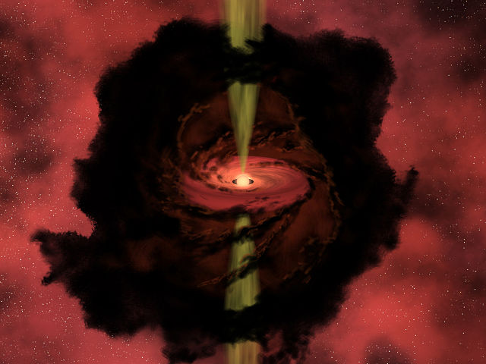
The birth of star
恒星的诞生

Slide 24
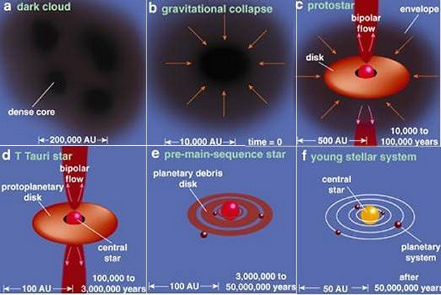
The birth of star
恒星的诞生

Slide 25
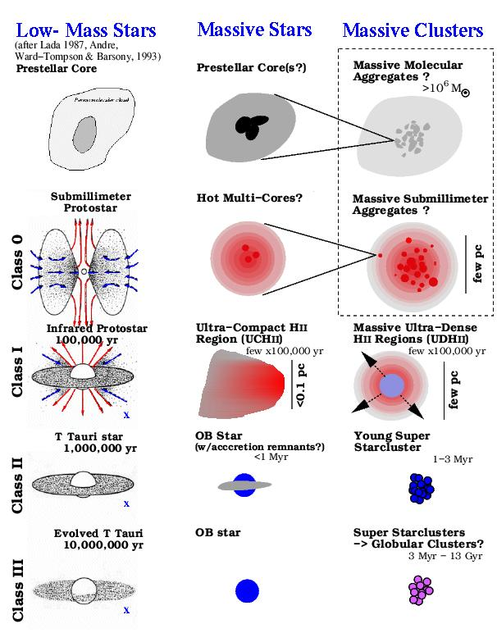
The birth of star
恒星的诞生

Slide 26
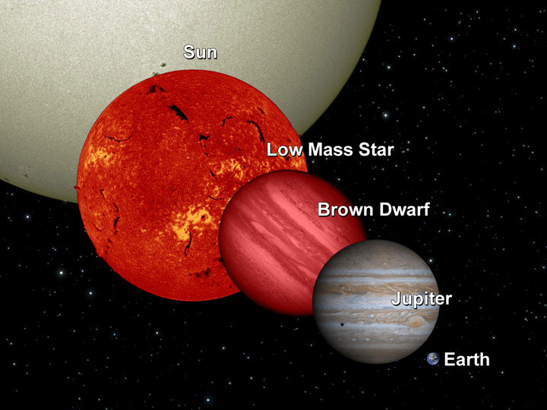
The birth of star
恒星的诞生
最大质量和最小质量：
最小质量： 0.08太阳质量；小于此质量的恒星被称为褐矮星（中心未有核反应）
最大质量：100-200太阳质量

Slide 27
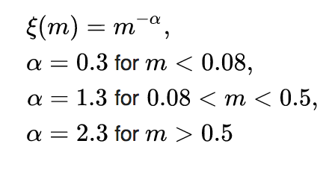
Initial mass function
初始质量函数
Kroupa 2001
Question: 已知银河系的恒星盘总质量为5×10¹⁰ 太阳质量，按照上述质量函数(0.08 – 100 太阳质量) ，请问银河系中有多少个像太阳这样质量的恒星 (1+/-0.1太阳质量)？

Slide 28
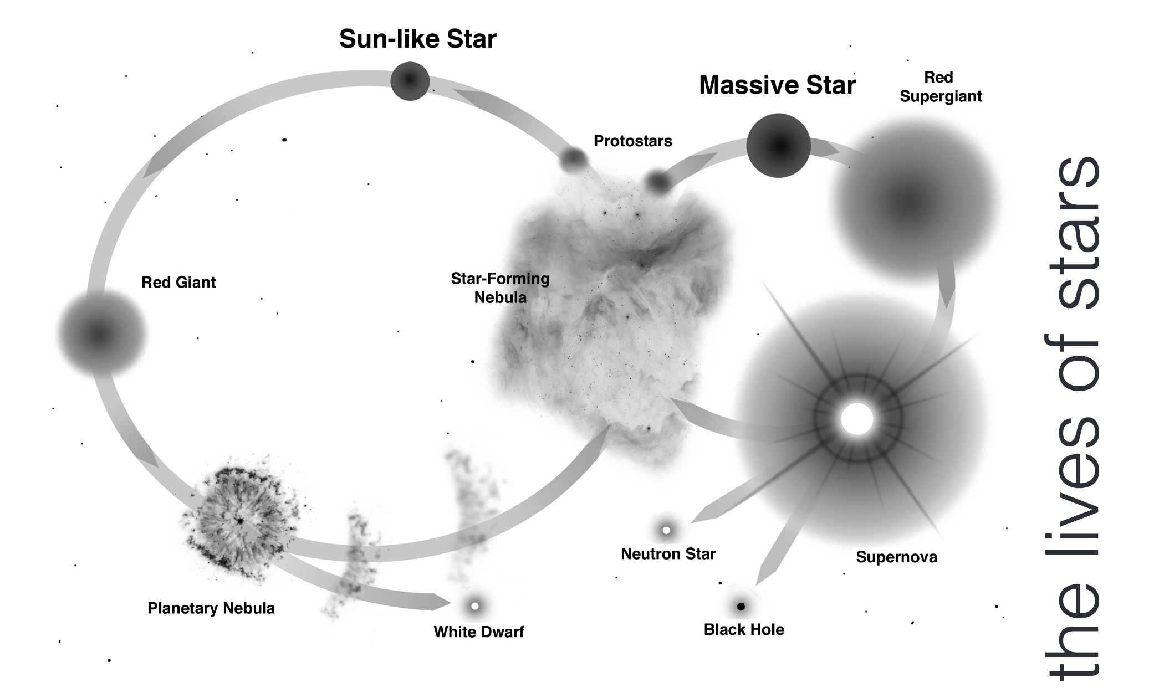
Stellar life cycle
恒星生命循环

Slide 29
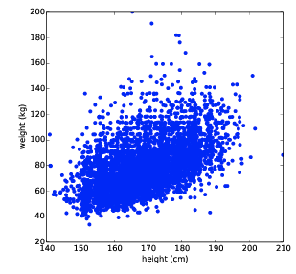
Hertzsprung-Russell diagram
赫罗图

Slide 30
Hertzsprung-Russell diagram
赫罗图

Slide 31
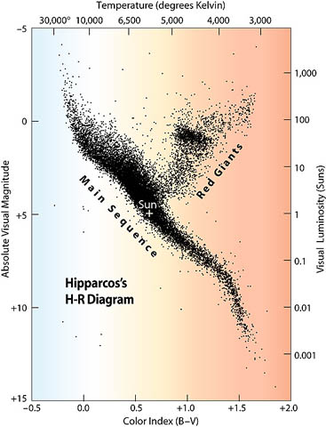
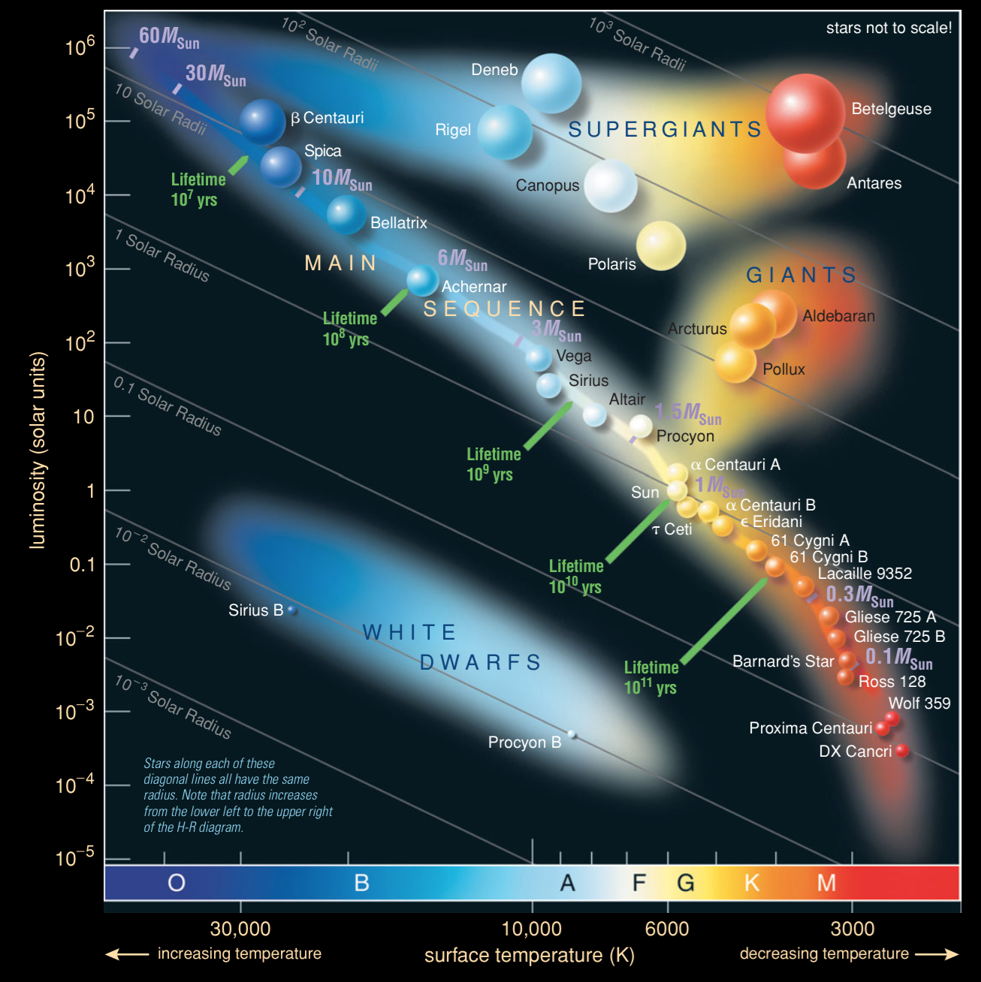
Hertzsprung-Russell diagram
赫罗图

Slide 32
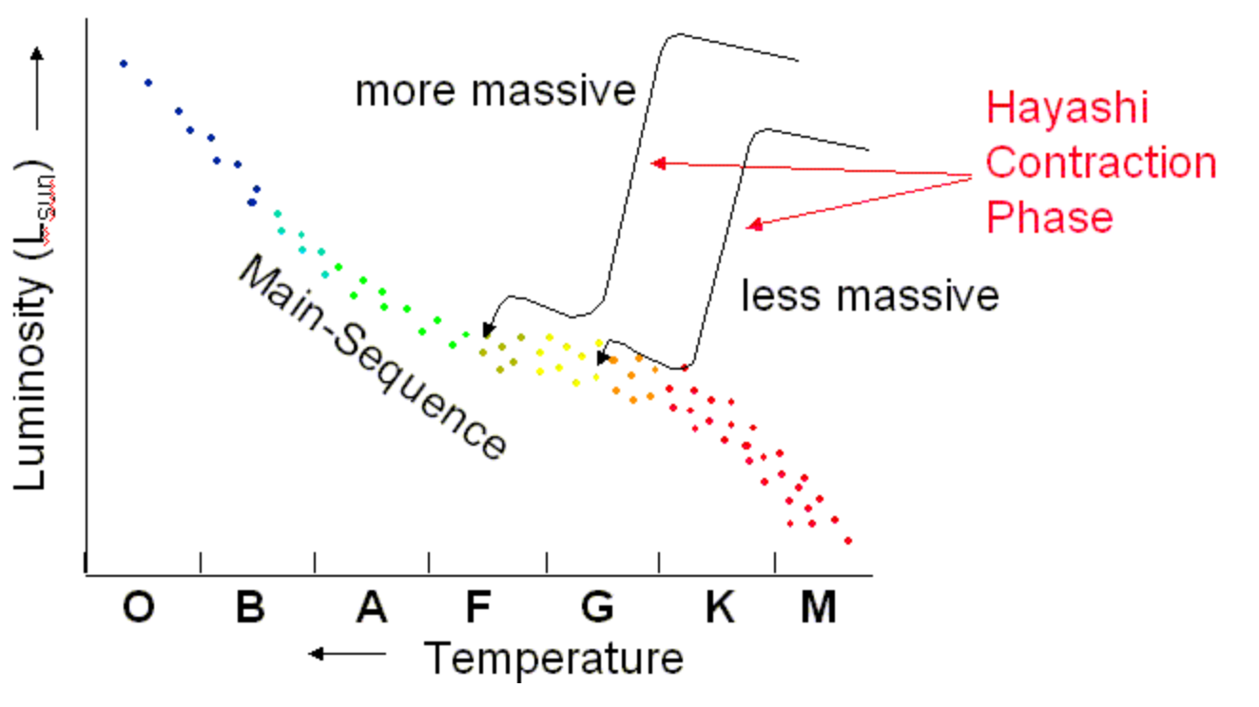
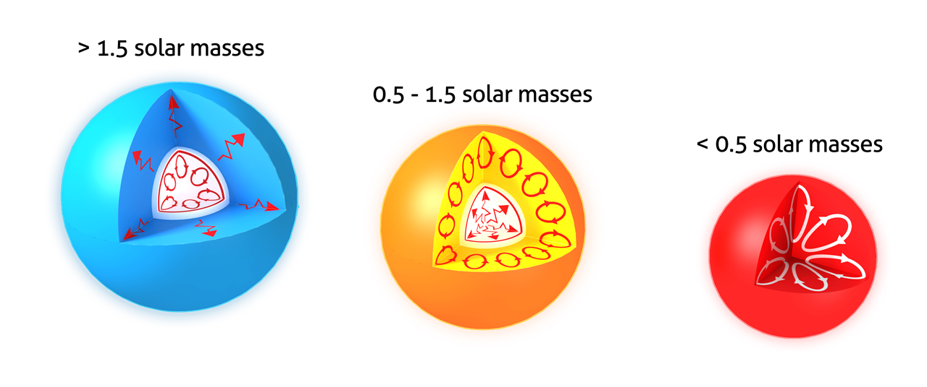
Hertzsprung-Russell diagram
赫罗图
Protostar Phase (50 million years for Sun)：
Gravitational Contraction until fusion starts
The Sun took about 50 million years to reach the main sequence
During the collapse phase it was brighter and cooler than it is on the Main Sequence
The paths of protostars in the H-R diagram are called the Hayashi Tracks

Slide 33
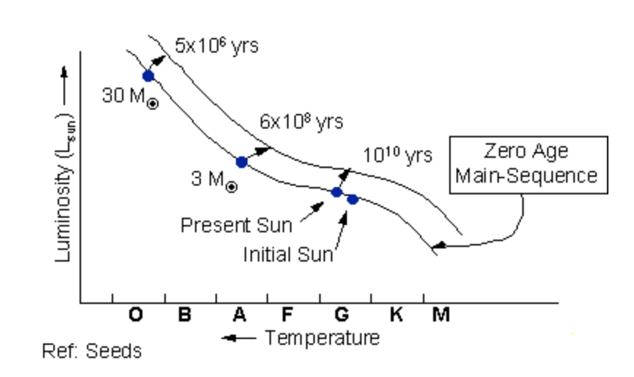
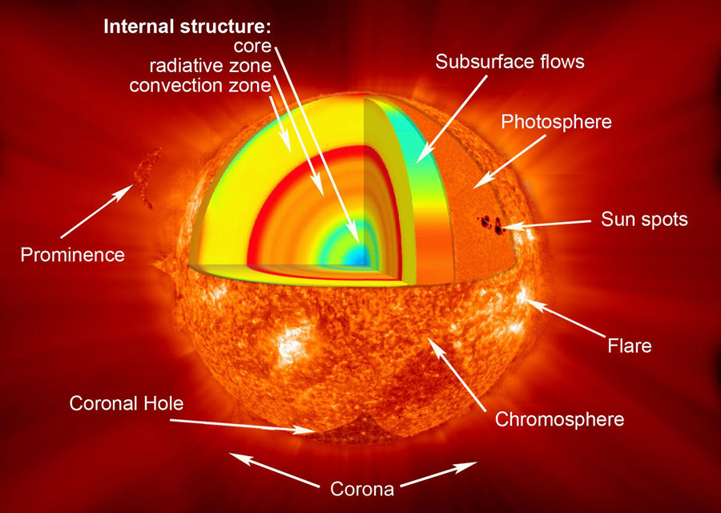
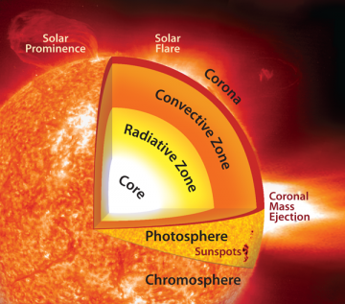
Hertzsprung-Russell diagram
赫罗图
MAIN SEQUENCE (10-11 billion years for Sun)
The Sun reached the Main Sequence about 4.5 billion years ago
At that time, it was fainter -- 0.70 x the luminosity of today's Sun
it was a little smaller -- 0.897 x the radius of today's sun
it was a little cooler -- 5586 K

Slide 34
Hertzsprung-Russell diagram
赫罗图
MAIN SEQUENCE (10-11 billion years for Sun)
On the Main Sequence, the Sun burns hydrogen to helium in the proton-proton process, and gets progressively hotter and brighter.
Question: 根据两核之间的库能势估计发生核反应需要的最小温度为多少K？

Slide 35
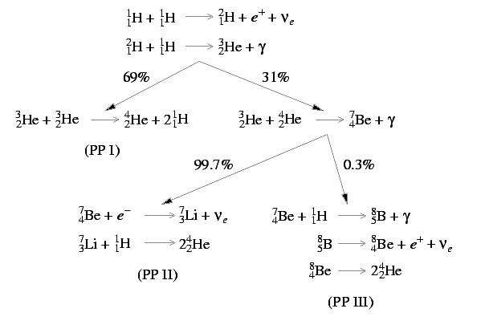
Hertzsprung-Russell diagram
赫罗图
MAIN SEQUENCE (10-11 billion years for Sun)
On the Main Sequence, the Sun burns hydrogen to helium in the proton-proton process, and gets progressively hotter and brighter.

Slide 36
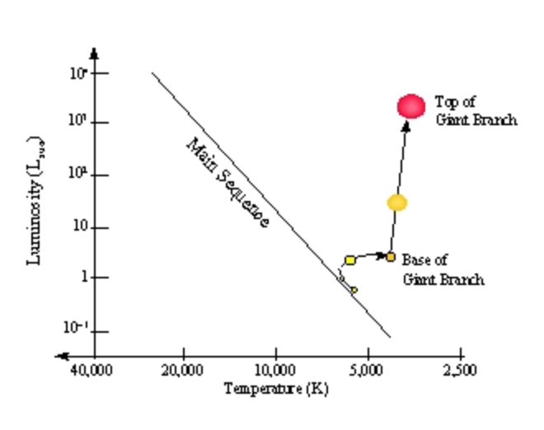
Hertzsprung-Russell diagram
赫罗图
Red giant (about 1 billion years for Sun)
Hydrogen is all converted into helium in the core
Helium core begins to collapse, since energy is no longer being produced to counteract the collapse by gravity
Hydrogen fusion to helium still occurs in a shell around the core
Star rearranges itself, eventually becoming a RED GIANT
Outer layers of the Sun expand, star becomes Larger , surface temperature is cool (red) , very luminous

Slide 37
Hertzsprung-Russell diagram
赫罗图
Red giant (about 1 billion years for Sun)
Hydrogen is all converted into helium in the core
Helium core begins to collapse, since energy is no longer being produced to counteract the collapse by gravity
Hydrogen fusion to helium still occurs in a shell around the core
Star rearranges itself, eventually becoming a RED GIANT
Outer layers of the Sun expand, star becomes Larger , surface temperature is cool (red) , very luminous

Slide 38
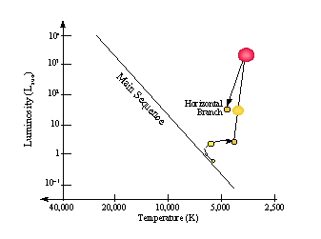
Hertzsprung-Russell diagram
赫罗图
The helium flash
When the core of the star gets hot enough, a new fusion process occurs: the TRIPLE ALPHA REACTION
Alpha = alpha particle = helium nucleus
Triple Alpha: 3 helium --> 1 Carbon + energy
The fusion of helium into carbon causes an enormous production of energy in a few seconds.
Again, the star rearranges itself to be hotter and smaller -- it becomes a so-called Horizontal branch star

Slide 39
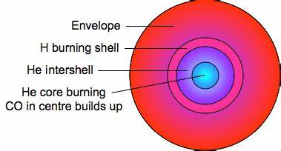
Hertzsprung-Russell diagram
赫罗图
The Horizontal Branch (red clump)
The Sun burns Helium into carbon and oxygen in its core as a horizontal branch star for about 100 million years
It still is burning Hydrogen to helium in a shell around the core
At this point the Sun will be about R=18 x solar radius today, T=4450 K, L=110 x luminosity of the Sun today

Slide 40
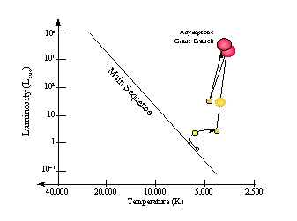
Hertzsprung-Russell diagram
赫罗图
The Asymptotic giant branch
Eventually, the helium in the core is used up.
The core is now Carbon and Oxygen and it begins to collapse.
There are shells of Helium burning and hydrogen burning still
During this phase, what's left of the outer layers of the star are blowing off in a wind, until the Sun's mass is about 0.6 x what it is today
At the top of the Asymptotic Giant Branch, the star starts to pulsate, and is very unstable

Slide 41
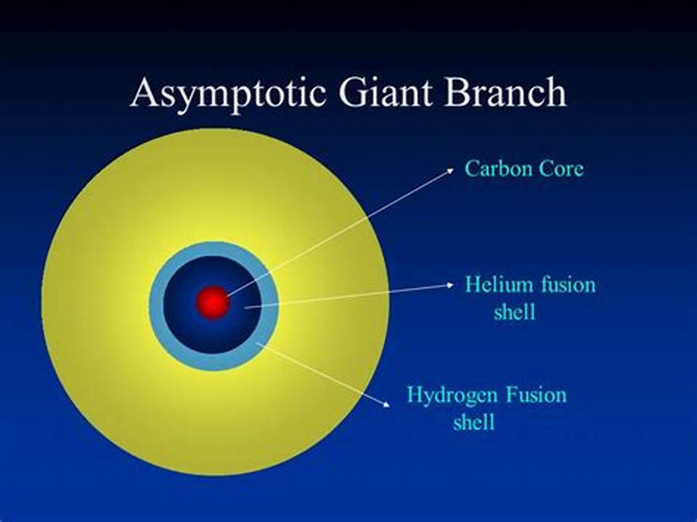
Hertzsprung-Russell diagram
赫罗图
The Asymptotic giant branch
Eventually, the helium in the core is used up.
The core is now Carbon and Oxygen and it begins to collapse.
There are shells of Helium burning and hydrogen burning still
During this phase, what's left of the outer layers of the star are blowing off in a wind, until the Sun's mass is about 0.6 x what it is today
At the top of the Asymptotic Giant Branch, the star starts to pulsate, and is very unstable

Slide 42
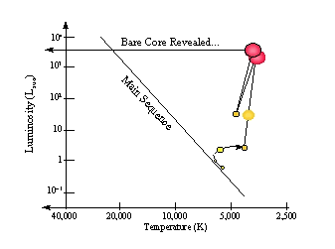
Hertzsprung-Russell diagram
赫罗图
Planetary Nebula Phase
Finally, the outer parts of the star are ejected. The core is extremely hot and dense, and lights up the ejected material in a "Planetary Nebula".
Short-lived phase, The ejection of the PNE takes 100,000 yrs, but then the planetary shines only 10,000 years
Despite the short lifetime of Planetary Nebulae, the stars which end up as PNE are common: in the Milky Way today, there are about 10,000 planetaries

Slide 43
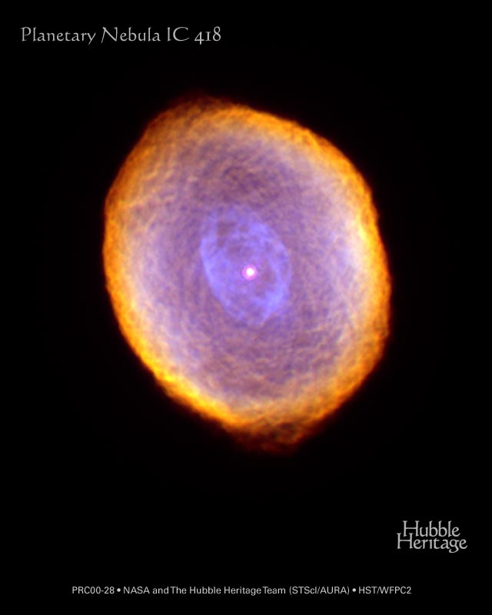
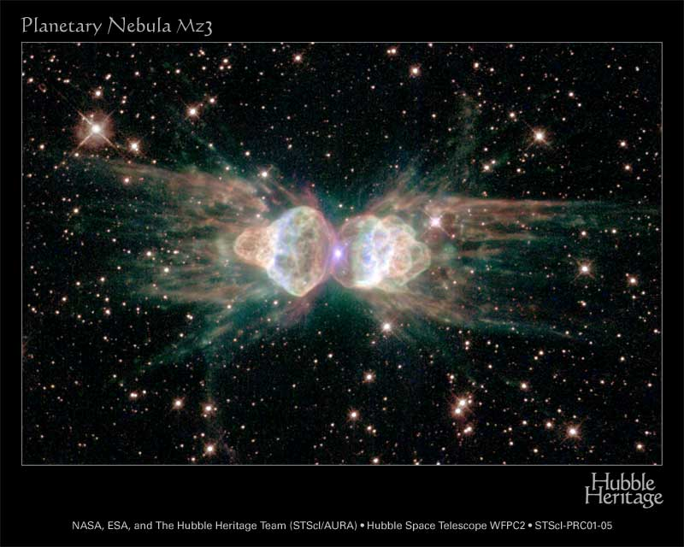
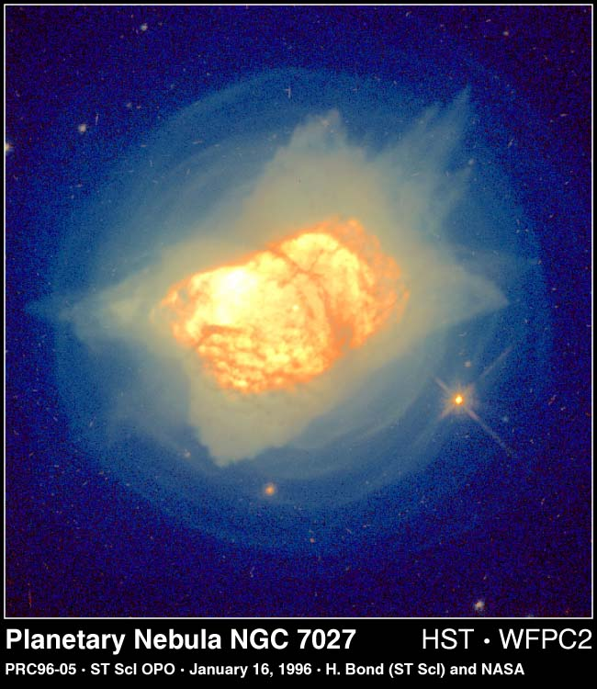
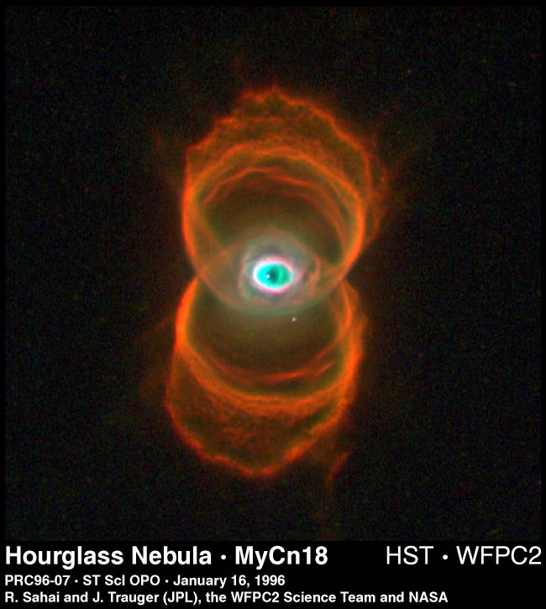
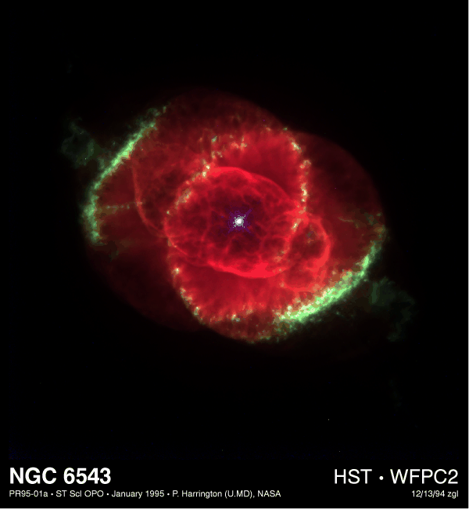
Hertzsprung-Russell diagram
赫罗图

Slide 44
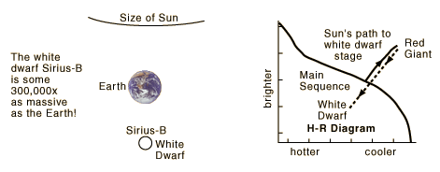
Hertzsprung-Russell diagram
赫罗图
White dwarf
The core collapses until ELECTRON DEGENERACY PRESSURE stops the gravitational
At this point, the star is a "White Dwarf" and slowly cools for the rest of time
Mass is about 0.5x solar mass today, but 200,000x more dense than Earth The Sun will then be about the same size as the Earth
A teaspoon of electron degenerate material would weigh 5 tons

Slide 45
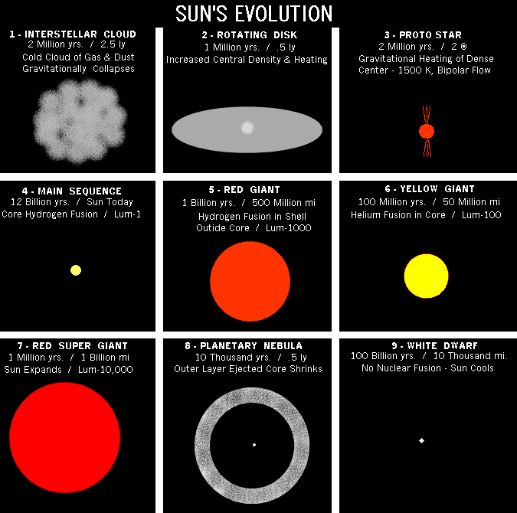
Hertzsprung-Russell diagram
赫罗图

Slide 46
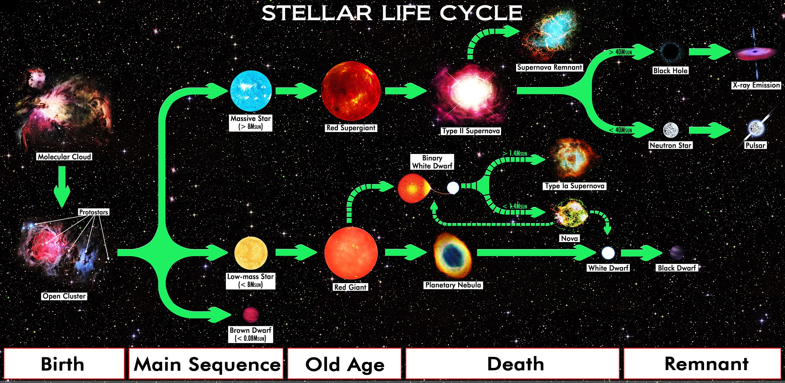
The death of star
恒星的死亡

Slide 47
The death of star
恒星的死亡

Slide 48
The death of star
恒星的死亡

Slide 49
Summary
总结
恒星是如何诞生的（金斯判据，初始质量函数）
恒星是如何演化的（不同演化阶段在赫罗图上的变化，恒星的能源机制是什么）
恒星的归宿（白矮星、中子星、黑洞）

Slide 50
前沿阅读

Slide 51
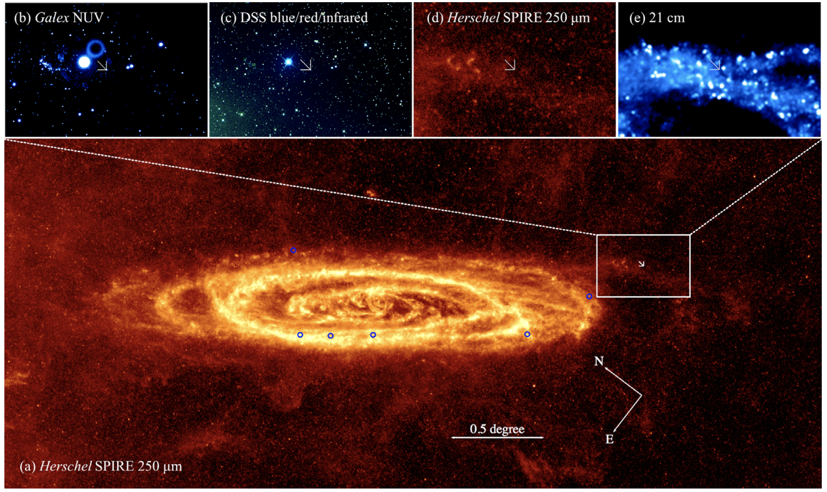
前沿阅读
Huang et al. 2019

Slide 52
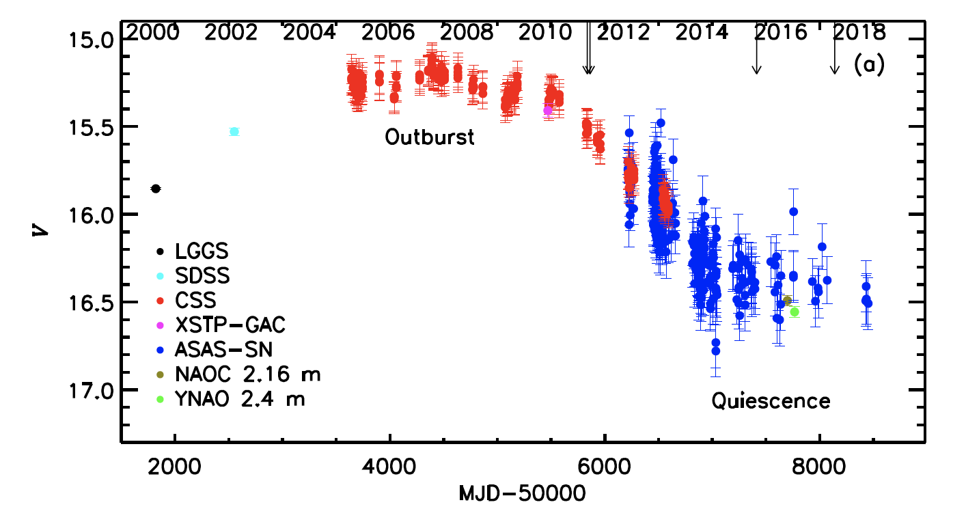
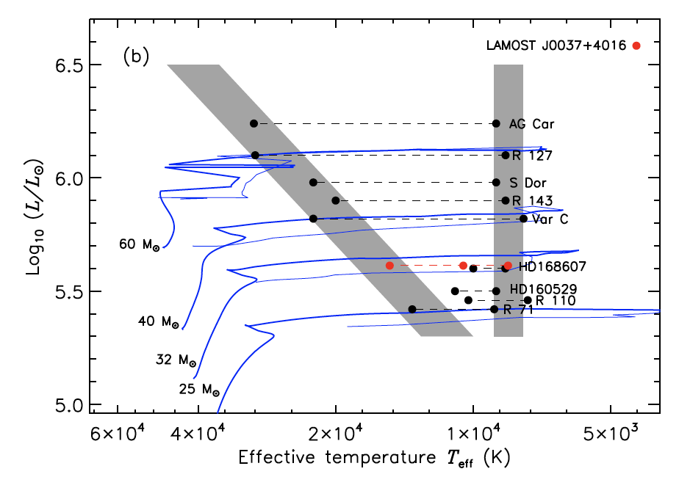
前沿阅读

