Slide 1



太阳与恒星
Yang Huang (黄样)
SWIFAR, YNU
(云南大学中国西南天文研究所)
https://yanghuang0.wixsite.com/yangh
银河下的郭守敬望远镜 (LAMOST) — 摄影苏晨

Slide 2
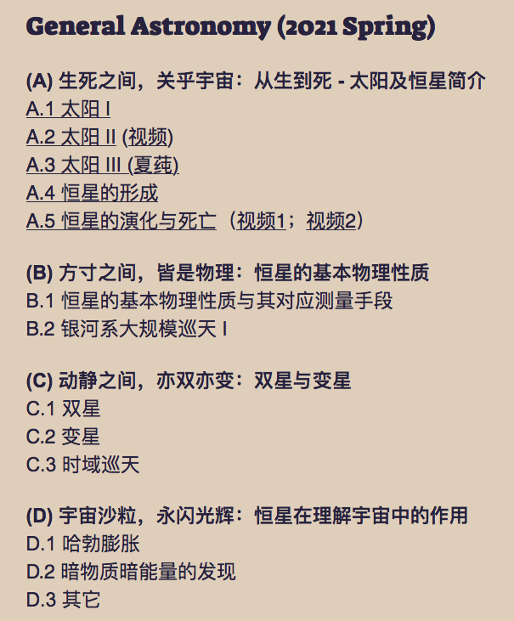
Outline (课程设计)

Slide 3
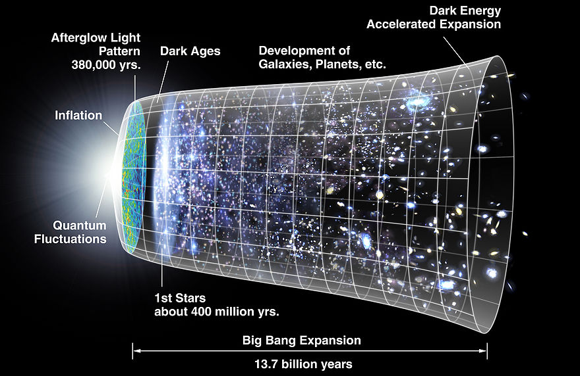
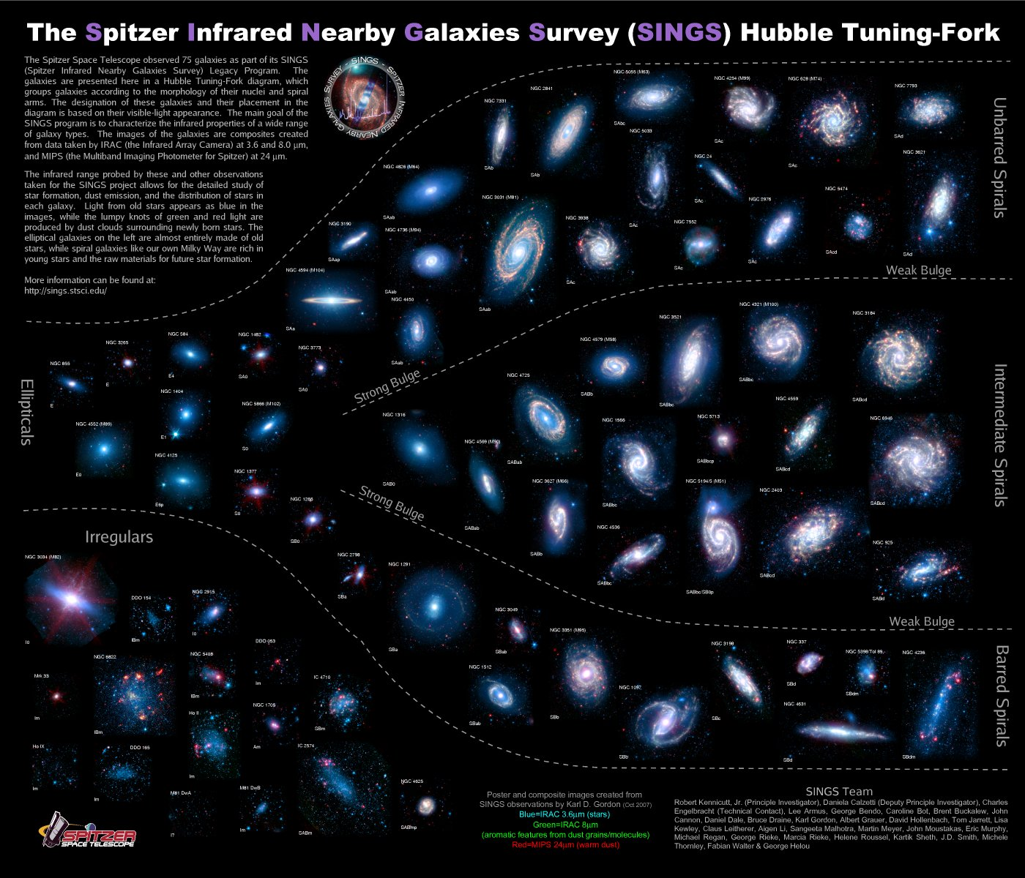
银河系大规模巡天
Galaxy: fundamental building block
Adopted from NASA
Adopted from SINGS group
Understanding how galaxies assemble and acquire their characteristic structure and properties (the “grand designs”) is one of the most challenging problems of modern astrophysics.

Slide 4
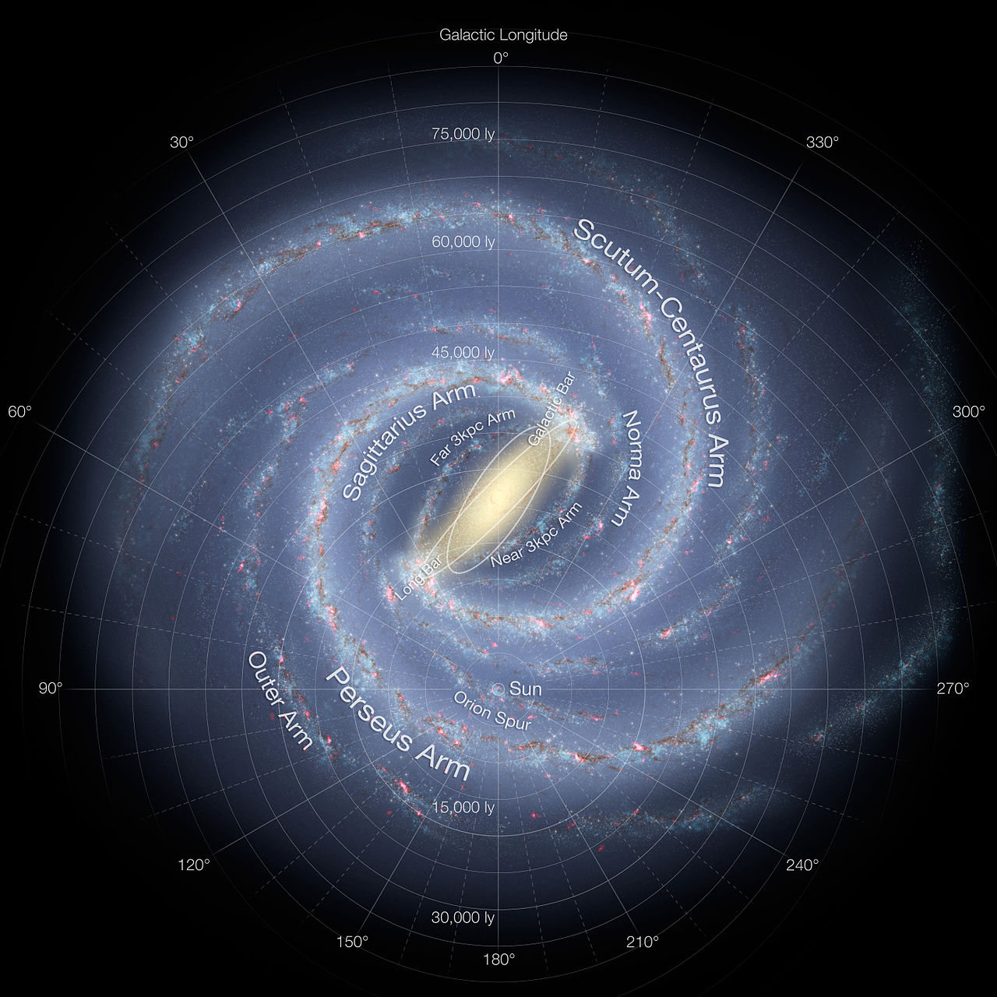
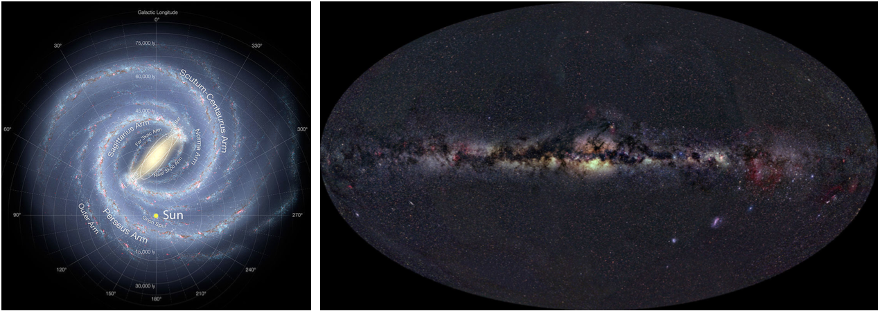
银河系大规模巡天
Face-on view
Edge-on view
Adopted from R. Hurt
Adopted from A. Mallenhoff
Milky Way is the only galaxy that can be studied in great detail and a good understanding of its stellar populations is important for our understanding of galaxy formation and evolution in general.

Slide 5
银河系大规模巡天
Face-on view
Edge-on view
Adopted from R. Hurt
Adopted from A. Mallenhoff
Challenges
  Billions of stars distributed over the whole sky of 4π steradian
  Obscuration of the interstellar dust grains
  Difficulty of obtaining reliable distances to individual stars

Slide 6
银河系大规模巡天
Face-on view
Edge-on view
Adopted from R. Hurt
Adopted from A. Mallenhoff
Challenges
  Billions of stars distributed over the whole sky of 4π steradian
  Obscuration of the interstellar dust grains
  Difficulty of obtaining reliable distances to individual stars
Need large-scale surveys of the Milky Way!

Slide 7
银河系大规模巡天
Adopted from A. Mallenhoff
Galaxy formation and evolution

Slide 8
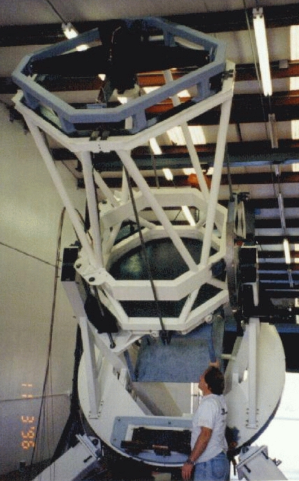
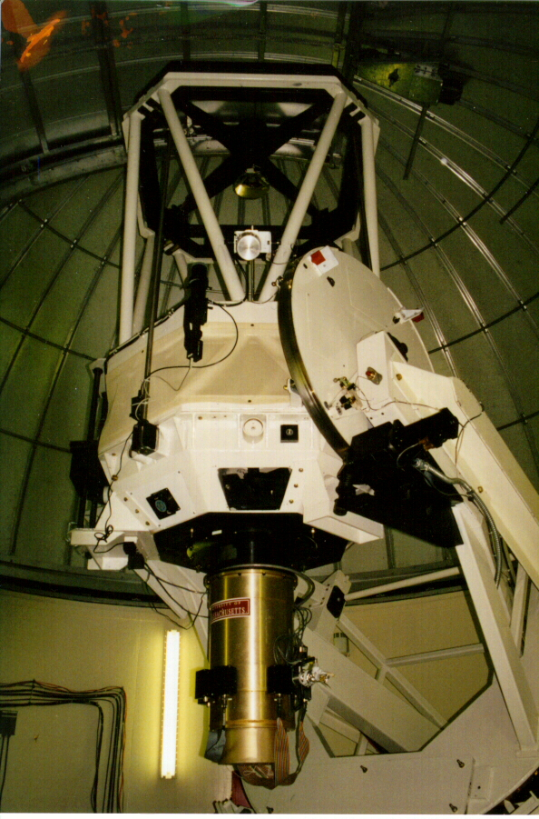
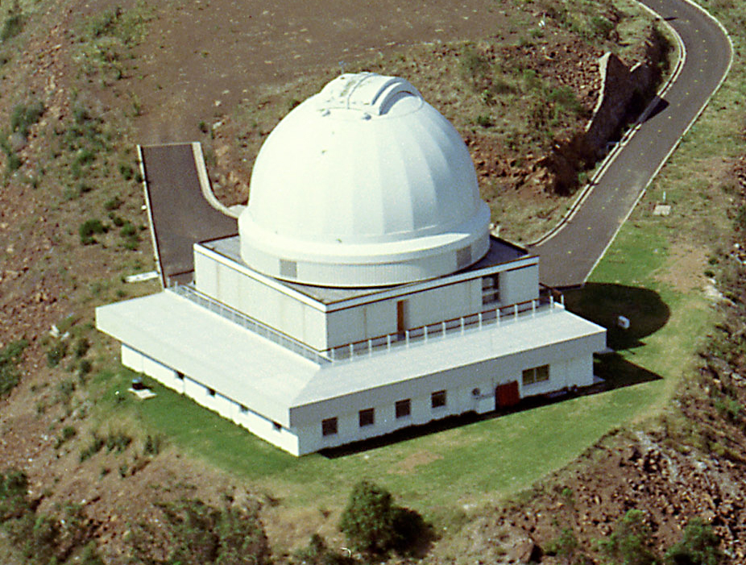

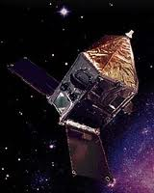

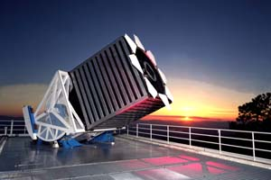
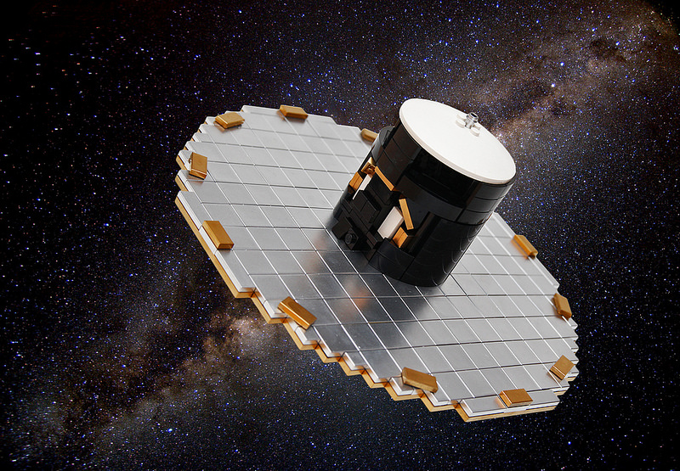

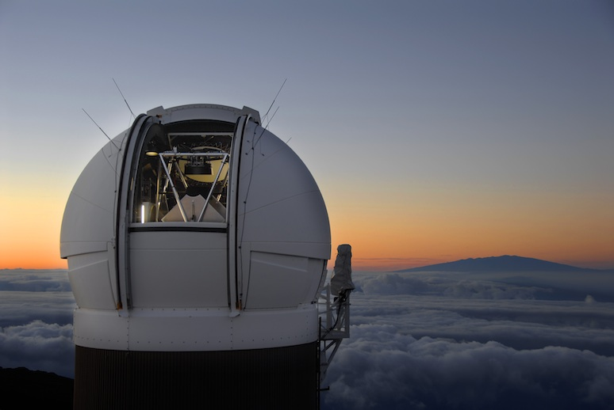
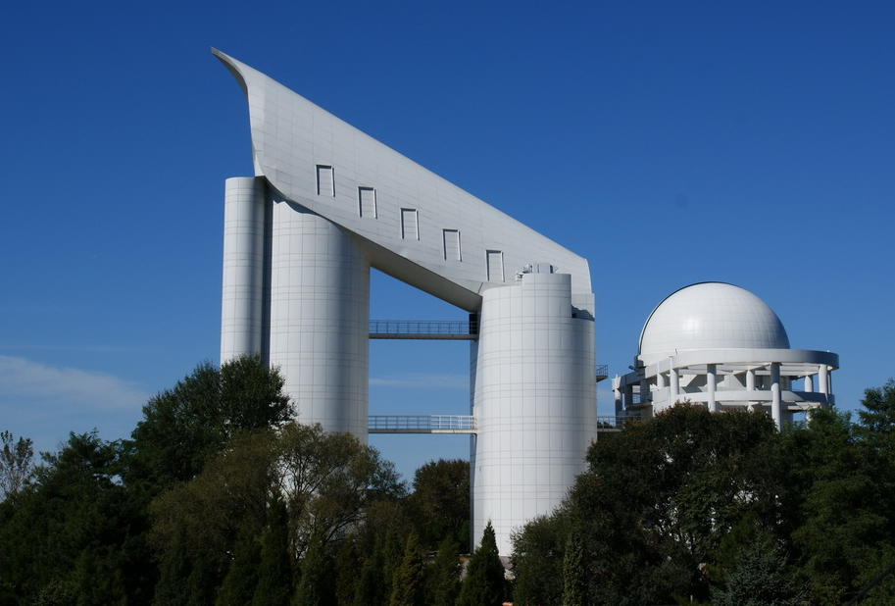

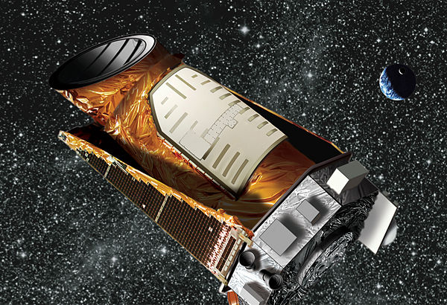
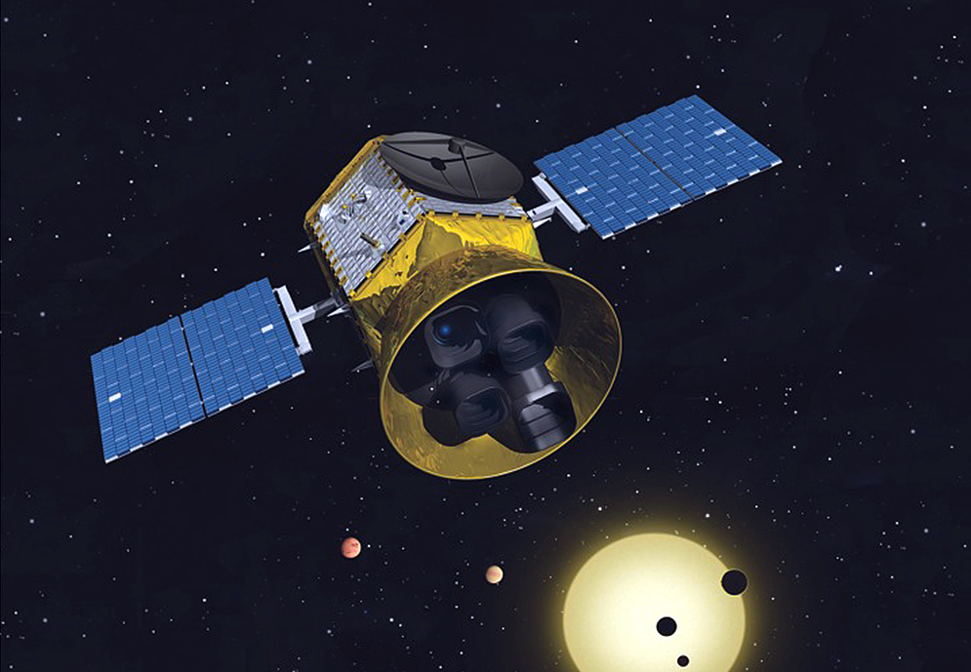
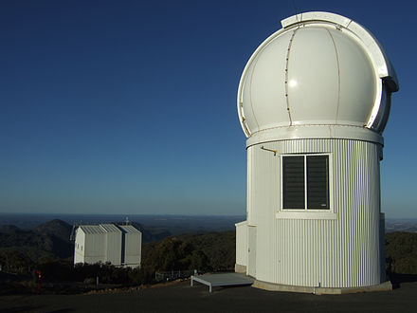

银河系大规模巡天
Astrometry
Photometry
Spectroscopy
Hipparcos
2MASS
RAVE
SDSS
Gaia
PS1
LAMOST
Kepler
TESS
Seismology
SkyMapper
Gaia

Slide 9
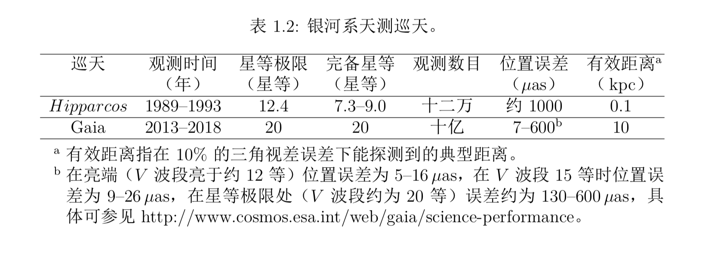
银河系大规模巡天

Slide 10
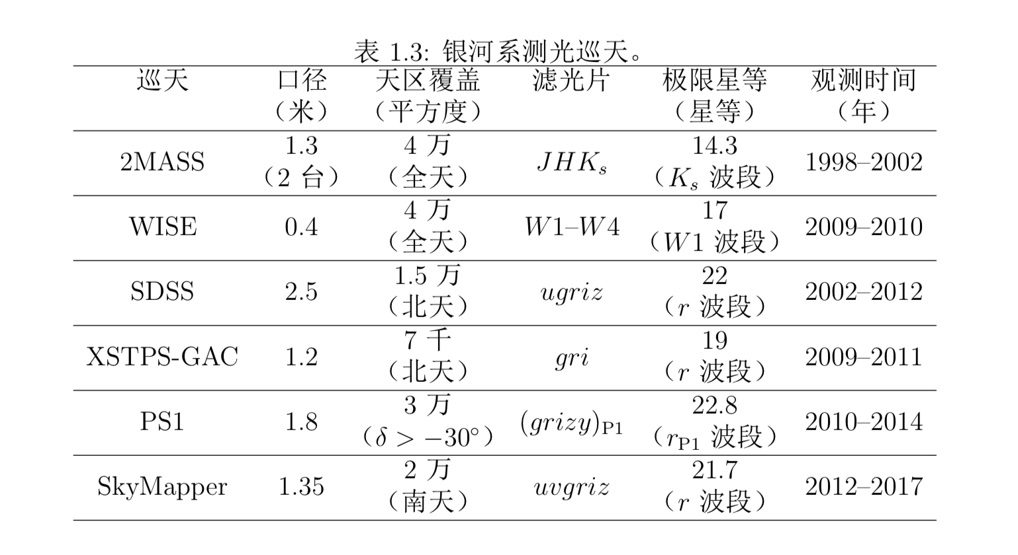
银河系大规模巡天

Slide 11
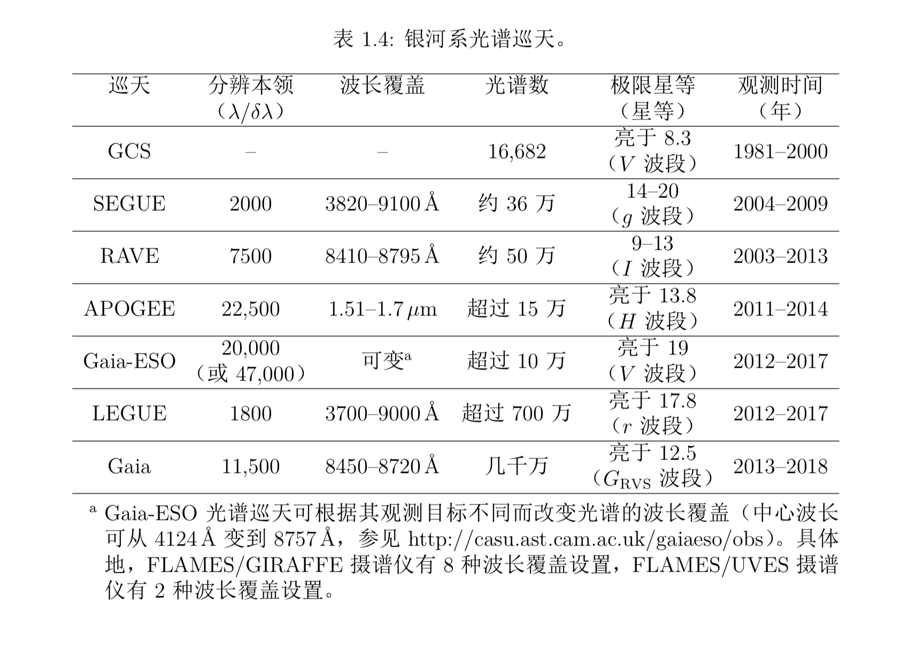
银河系大规模巡天

