Slide 1
太阳与恒星
Yang Huang (黄样)
SWIFAR, YNU
(云南大学中国西南天文研究所)
https://yanghuang0.wixsite.com/yangh
银河下的郭守敬望远镜 (LAMOST) — 摄影苏晨
Notes:
https://www.bilibili.com/video/av28891920/
https://www.1905.com/vod/play/874091.shtml
https://www.bilibili.com/video/av2989266

Slide 2
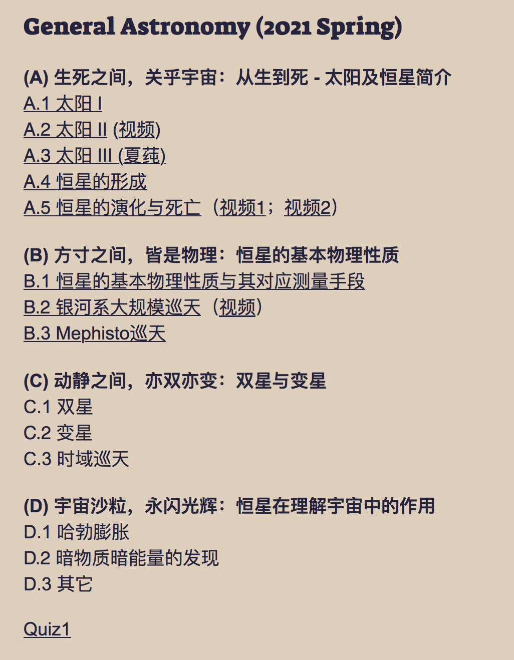
Outline (课程设计)

Slide 3
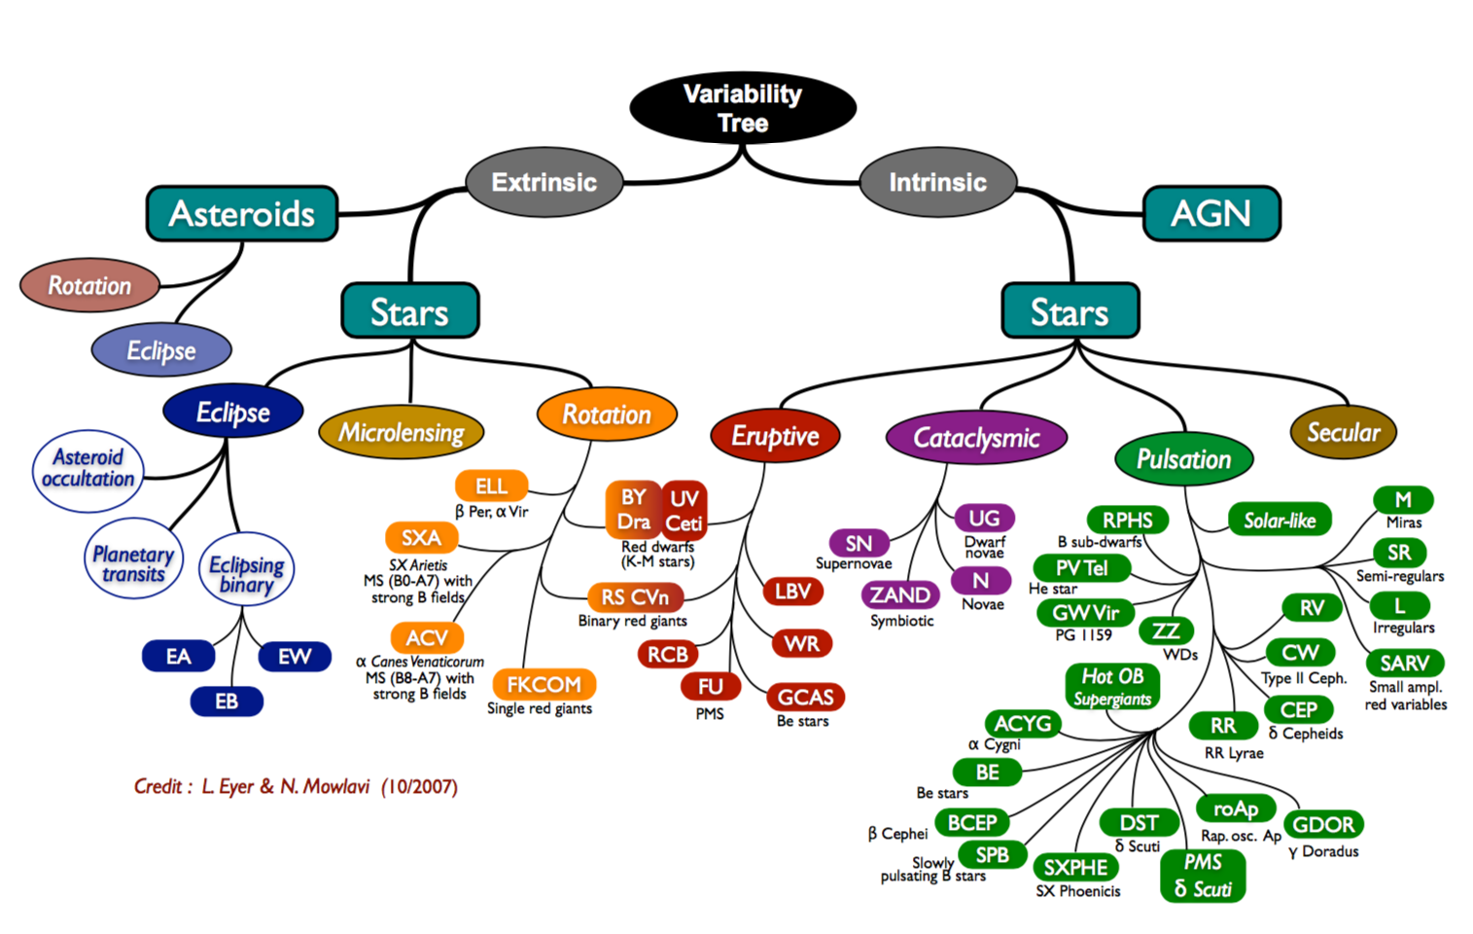
Variable stars

Slide 4
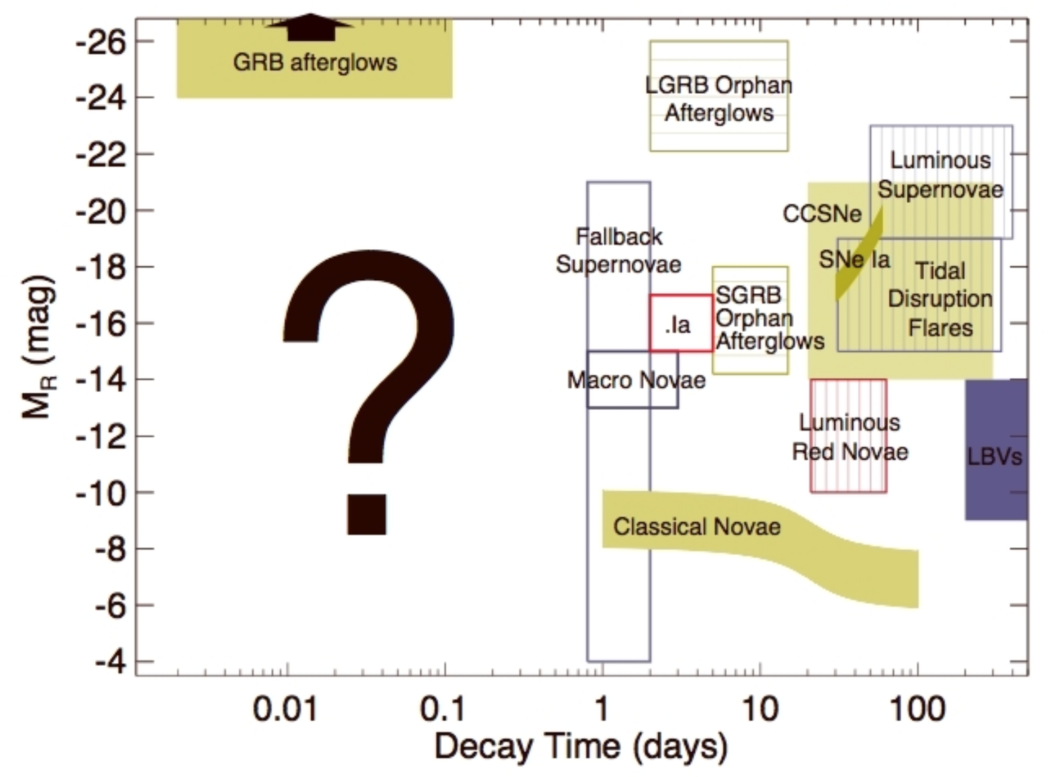
Variable stars
Ivezic et al. (2008)

Slide 5
Intrinsic variable star
Intrinsic variable stars: stars where the variability is being caused by changes in the physical properties of the stars themselves. This category can be divided into three subgroups:
Pulsating variables: stars whose radius alternately expands and contracts as part of their natural evolutionary ageing process.
Eruptive variables: stars who experience eruptions on their surfaces like flares or mass ejections.
Cataclysmic or explosive variables: stars that undergo a cataclysmic change in their properties like novae and supernovae.

Slide 6
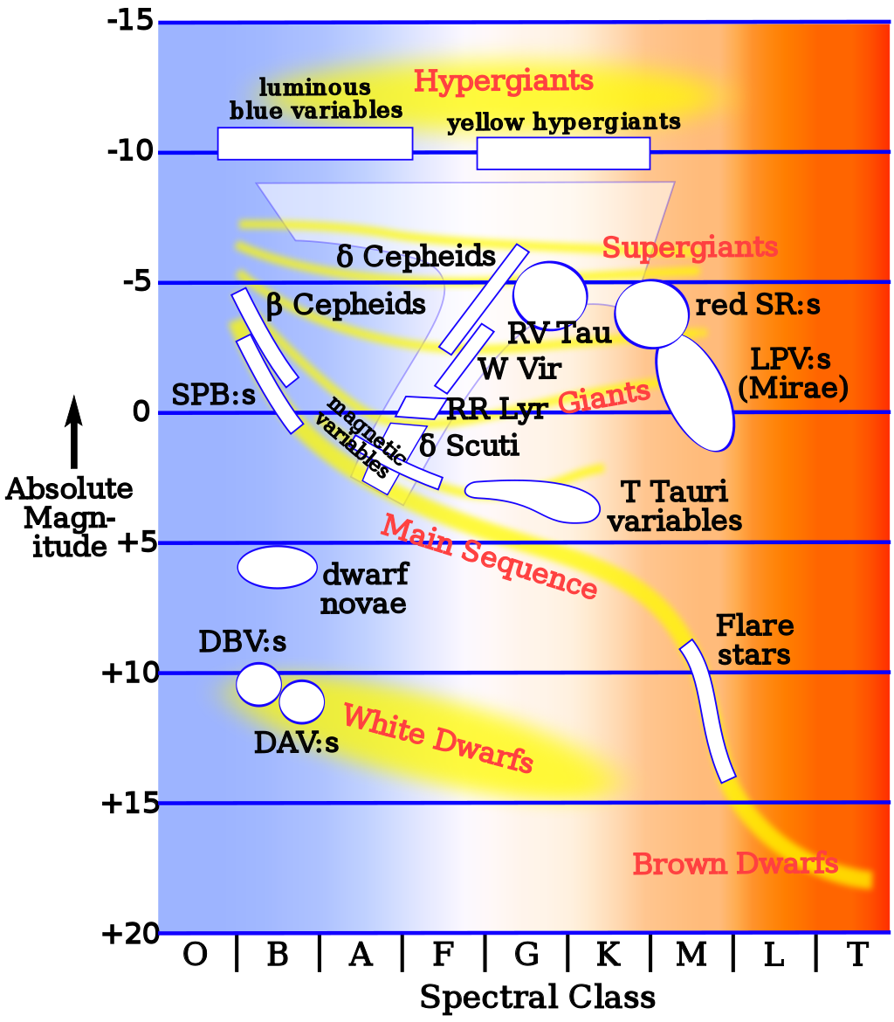
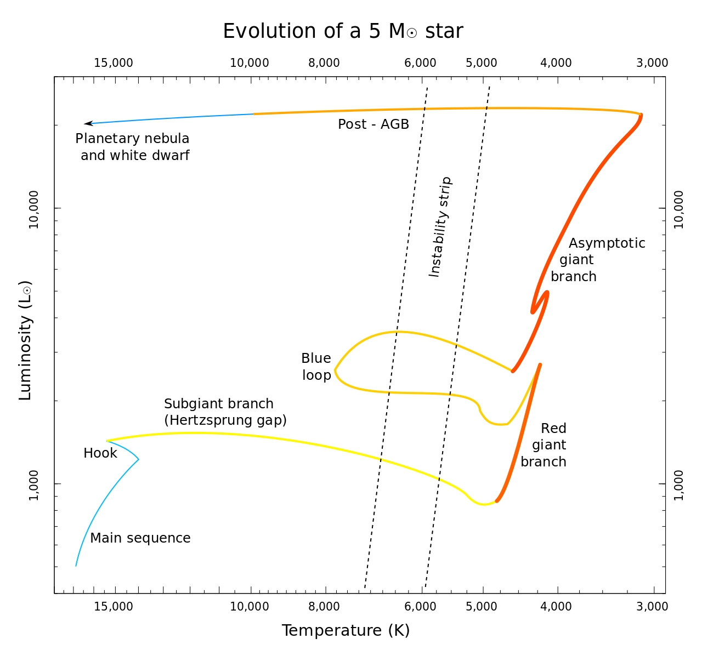
Intrinsic variable star
Pulsating variables: stars whose radius alternately expands and contracts as part of their natural evolutionary ageing process.

Slide 7
Intrinsic variable star
Pulsating variables: stars whose radius alternately expands and contracts as part of their natural evolutionary ageing process.
Classical Cepheid variables: Classical Cepheids (or Delta Cephei variables) are population I (young, massive, and luminous) yellow supergiants which undergo pulsations with very regular periods on the order of days to months.
Type II Cepheids: have extremely regular light pulsations and a luminosity relation much like the δ Cephei variables, so initially they were confused with the latter category. Type II Cepheids stars belong to older Population II stars, than do the type I Cepheids. The Type II have somewhat lower metallicity, much lower mass, somewhat lower luminosity, and a slightly offset period verses luminosity relationship, so it is always important to know which type of star is being observed.
RR Lyrae variables: These stars are somewhat similar to Cepheids, but are not as luminous and have shorter periods. They are older than type I Cepheids, belonging to Population II, but of lower mass than type II Cepheids. Due to their common occurrence in globular clusters, they are occasionally referred to as cluster Cepheids. They also have a well established period-luminosity relationship, and so are also useful as distance indicators. These A-type stars vary by about 0.2–2 magnitudes over a period of several hours to a day or more.

Slide 8
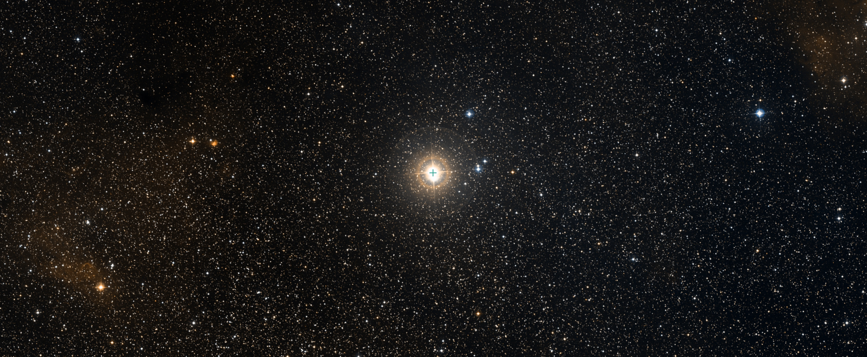
Intrinsic variable star
Pulsating variables: stars whose radius alternately expands and contracts as part of their natural evolutionary ageing process.
仙王座 δ：造父一
1784年 约翰·古德利克

Slide 9
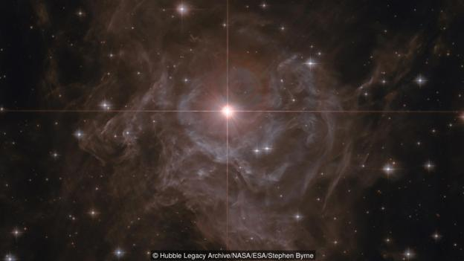
Intrinsic variable star
Pulsating variables: stars whose radius alternately expands and contracts as part of their natural evolutionary ageing process.
船尾座RS

Slide 10
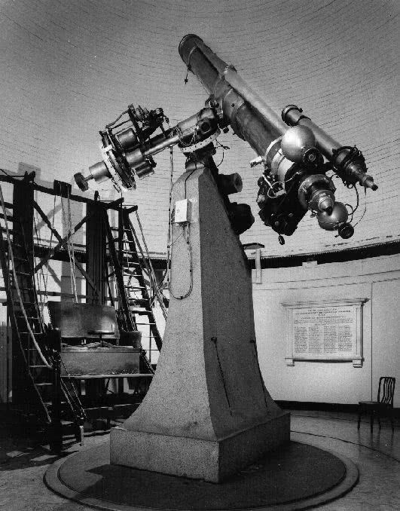
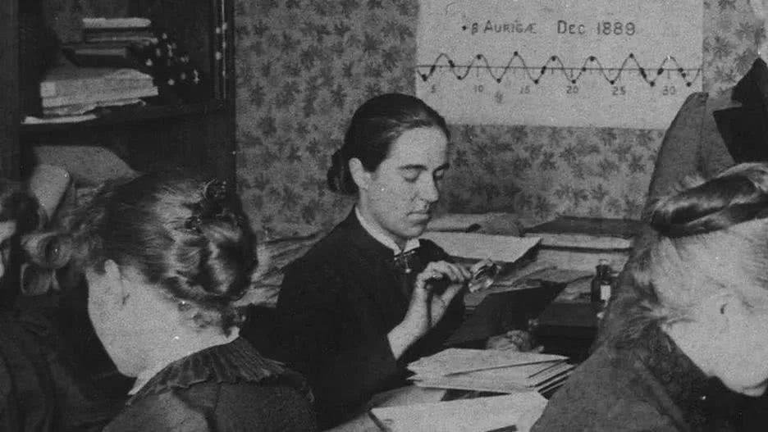
Intrinsic variable star
Pulsating variables: stars whose radius alternately expands and contracts as part of their natural evolutionary ageing process.
亨丽爱塔·斯万·勒维特

Slide 11
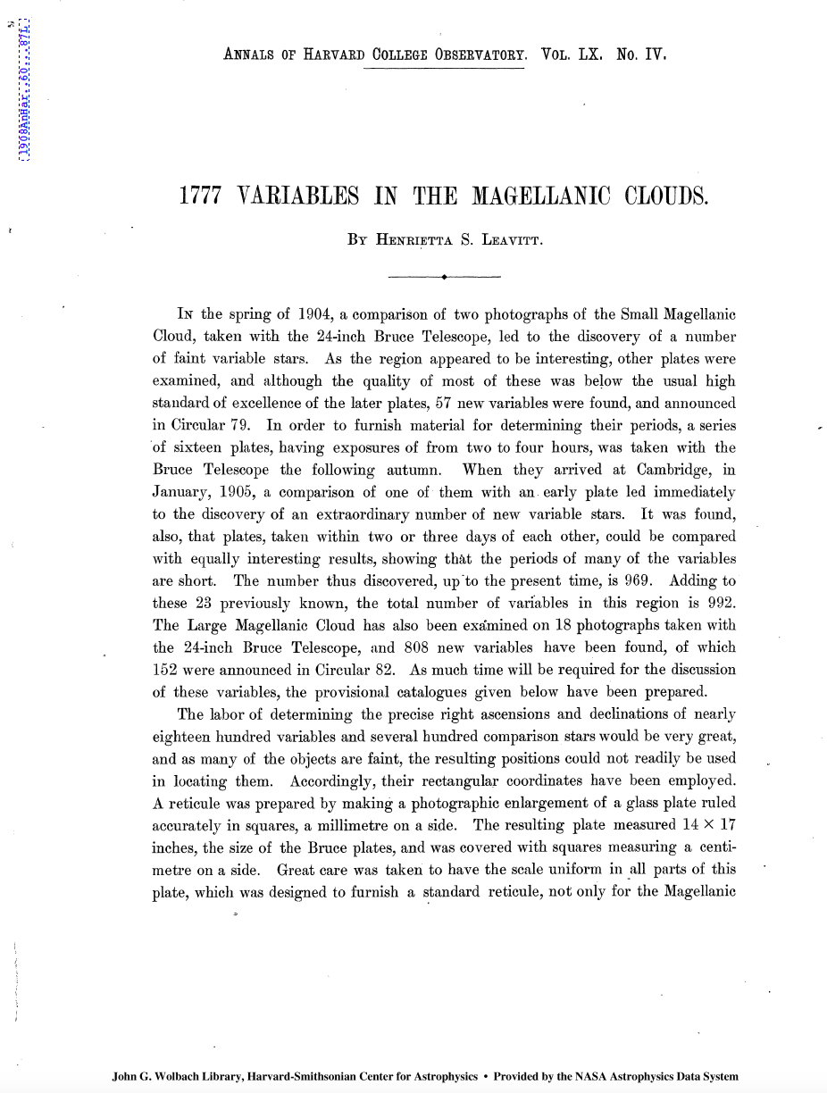
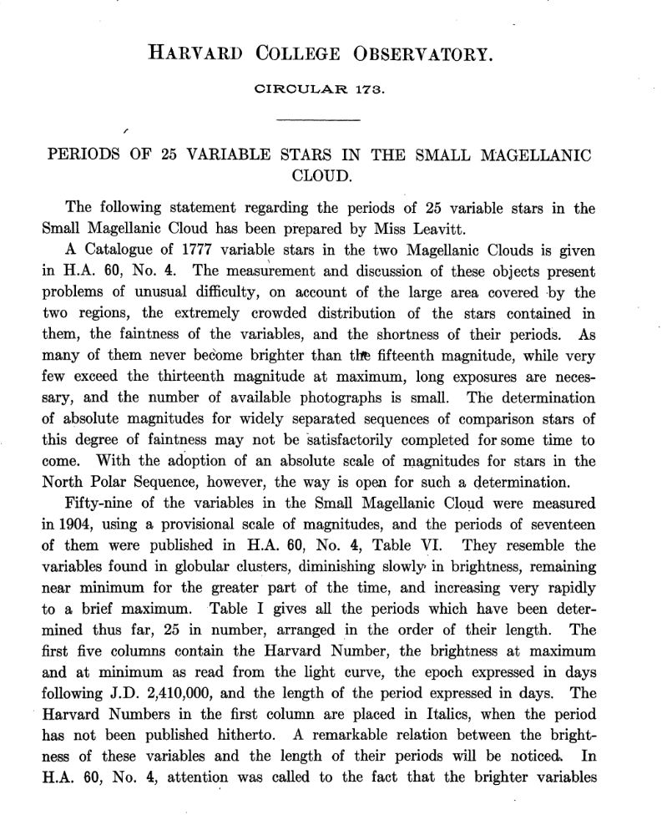
Intrinsic variable star
Pulsating variables: stars whose radius alternately expands and contracts as part of their natural evolutionary ageing process.

Slide 12
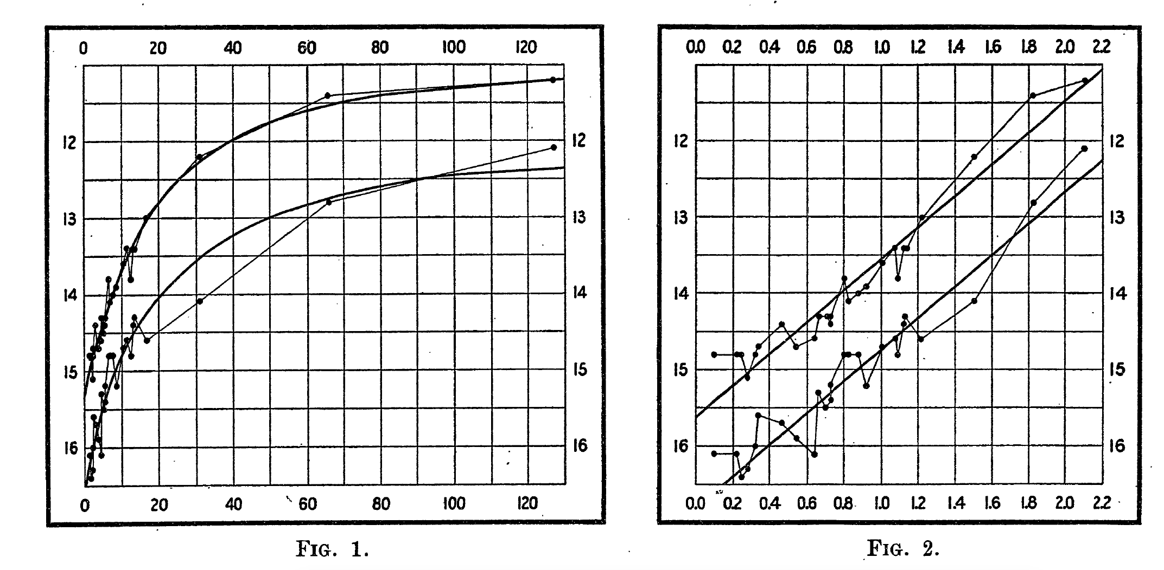
Intrinsic variable star
Pulsating variables: stars whose radius alternately expands and contracts as part of their natural evolutionary ageing process.

Slide 13
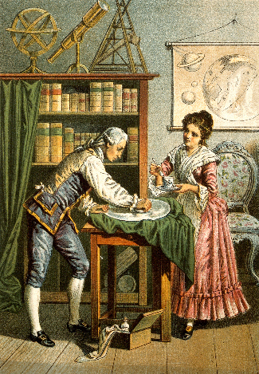
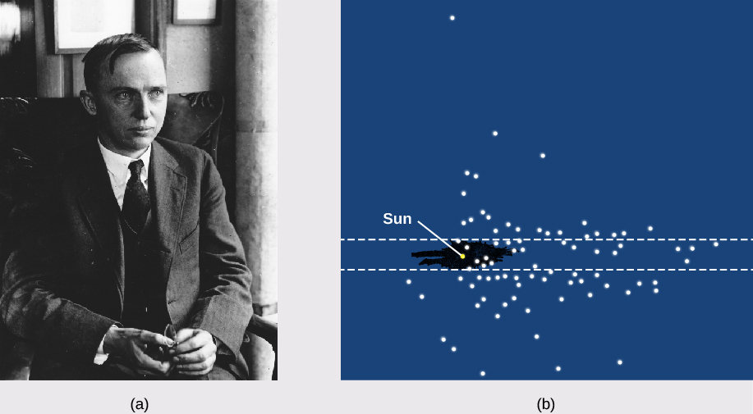
Intrinsic variable star
Pulsating variables: stars whose radius alternately expands and contracts as part of their natural evolutionary ageing process.
Williams Heschel
Harlow Shapley

Slide 14
Intrinsic variable star
“The great debate” at 1920.04.26

Slide 15
Intrinsic variable star
“The great debate” at 1920.04.26
@美国国家博物馆

Slide 16
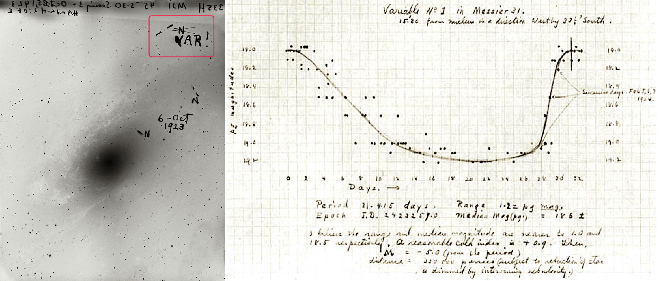
Intrinsic variable star
Pulsating variables: stars whose radius alternately expands and contracts as part of their natural evolutionary ageing process.

Slide 17
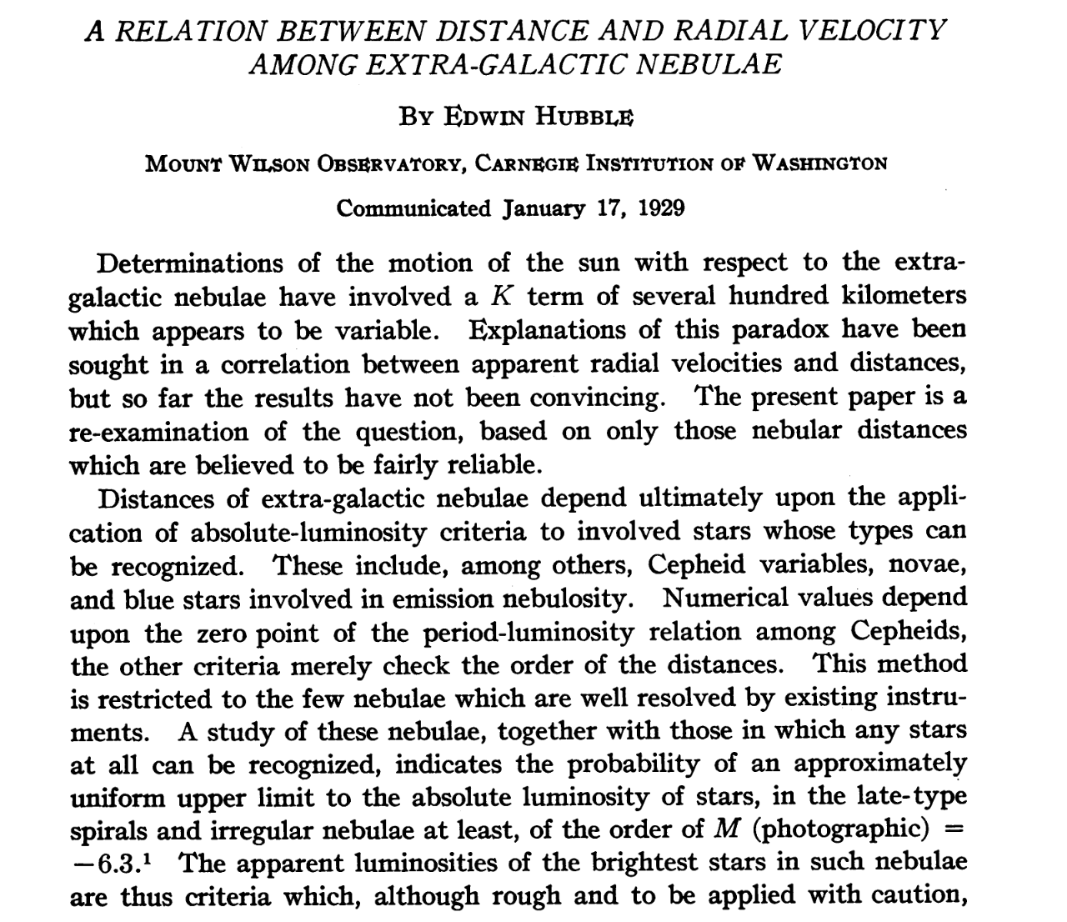
Intrinsic variable star
Pulsating variables: stars whose radius alternately expands and contracts as part of their natural evolutionary ageing process.
Hubble, PNAS, 1929

Slide 18
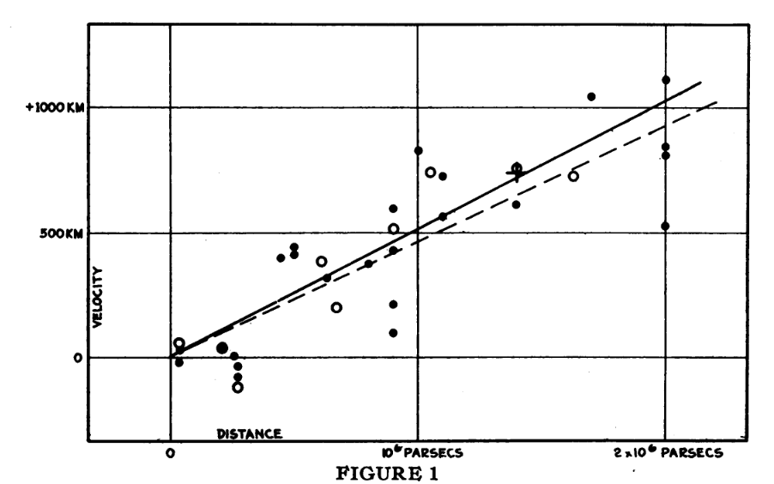
Intrinsic variable star
Pulsating variables: stars whose radius alternately expands and contracts as part of their natural evolutionary ageing process.
V = H₀D
H₀ = 60-70 km/s/Mpc

Slide 19
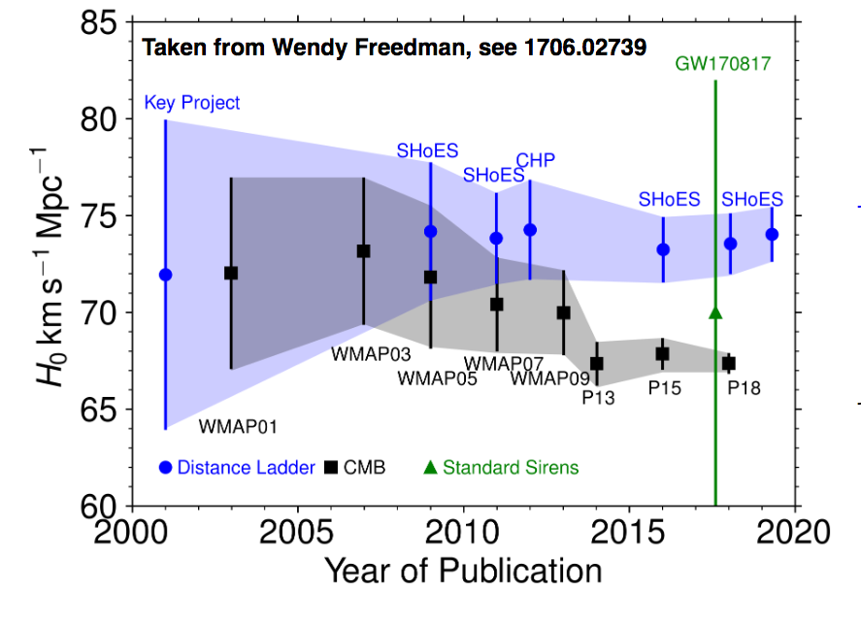
Intrinsic variable star
Pulsating variables: stars whose radius alternately expands and contracts as part of their natural evolutionary ageing process.
Hubble tension?

Slide 20
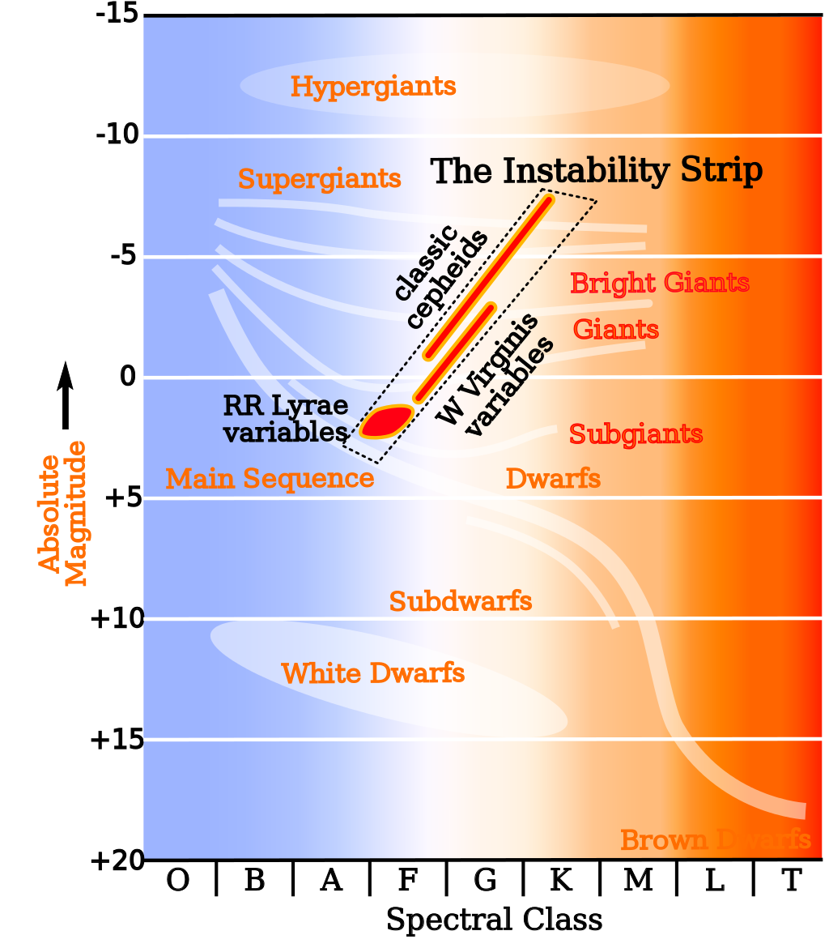
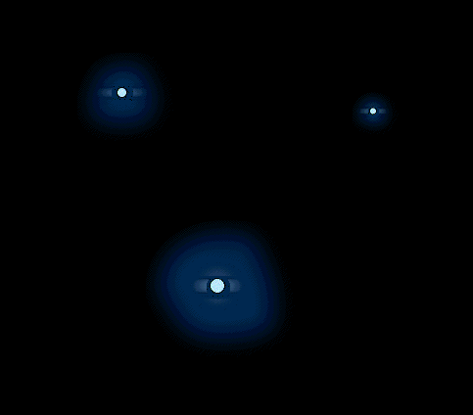
Intrinsic variable star
Pulsating variables: stars whose radius alternately expands and contracts as part of their natural evolutionary ageing process.

Slide 21
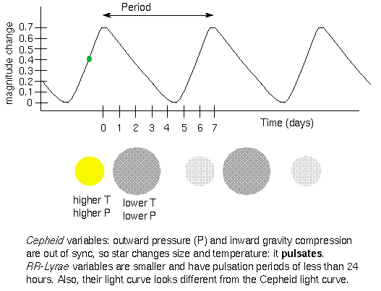
Intrinsic variable star
Pulsating variables: stars whose radius alternately expands and contracts as part of their natural evolutionary ageing process.

Slide 22
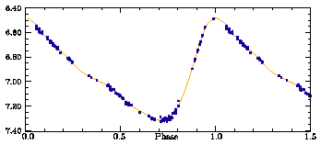
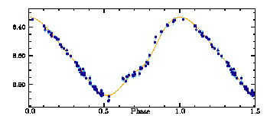
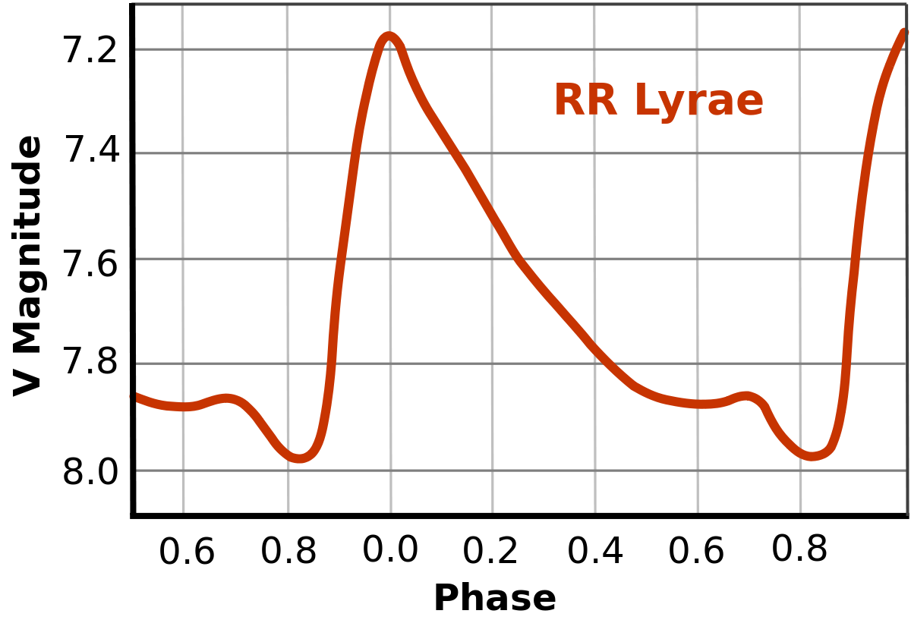
Intrinsic variable star
Pulsating variables: stars whose radius alternately expands and contracts as part of their natural evolutionary ageing process.

Slide 23
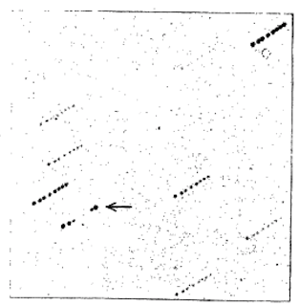
The discovery history of RR Lyrae stars
Pickering developed a technique for obtaining multiple photographic exposures of a star in a short amount of time -- a primitive but effective form of time-series photometry. A photographic plate was alternately exposed and covered over preestablished intervals in a telescope whose alignment and tracking rate were not precisely aligned with the sky. The result is that multiple exposures of a given star were obtained during an evening's observing, and that the periods for short stars might be more efficiently obtained.
Pickering 1898

Slide 24
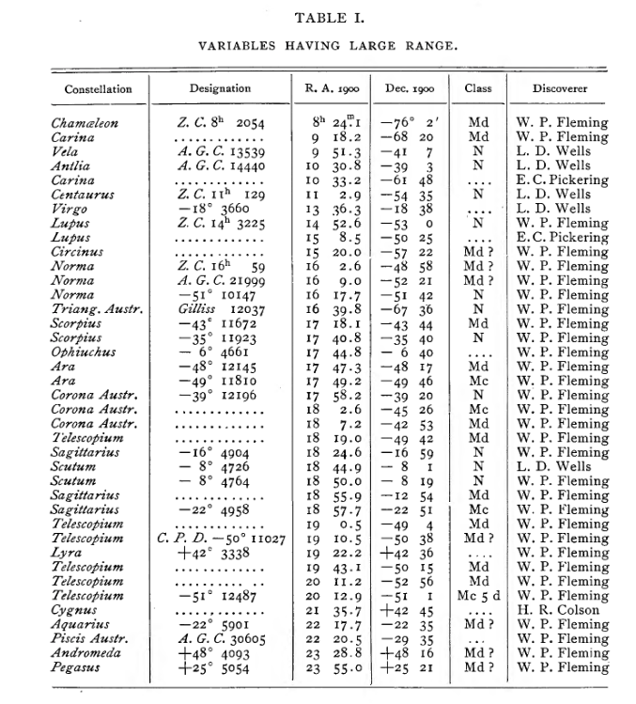
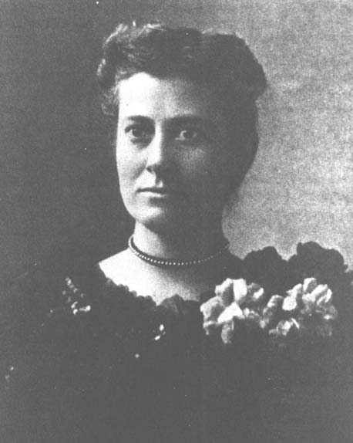
The discovery history of RR Lyrae stars
Pickering 1901
Fleming

Slide 25
The nature of RR Lyrae stars
RR Lyrae are variable, horizontal branch stars with periods ranging from a few hours to 1 days, and optical brightnesses that typically vary between 0.3 and 2 magnitudes. They lie in the instability strip of the Hertzsprung-Russell diagram and suffer instabilities that cause their size to periodically change. This change in size also changes the temperature of the star giving rise to their variability. RR Lyrae are low metallicity (population II) stars that begin their lives with a mass and size similar or slightly smaller to that of our Sun. They are generally found in globular clusters, as well as the bulge and halo of the Milky Way.

Slide 26
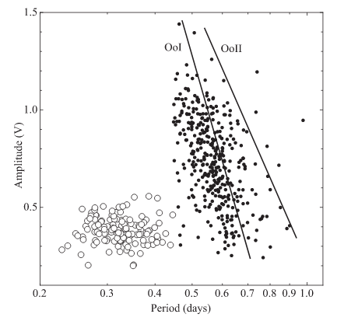
The nature of RR Lyrae stars
RRab variables (fundamental-mode pulsators) are the most common, making up 91% of all observed RR Lyrae, and display the steep rises in brightness typical of RR Lyrae. Period between 0.4 and 1.0 days.
RRc (First-overtone pulsators) are less common, making up 9% of observed RR Lyrae, and have shorter periods and more sinusoidal variation. Period between 0.20 and 0.5 days.
RRd (Double-mode pulsators) are rare, making up between <1%.

Slide 27
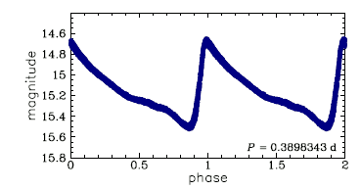
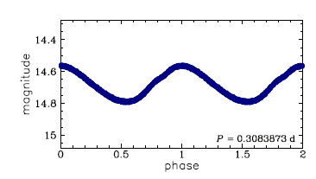
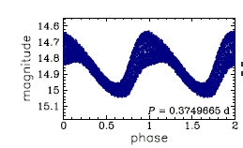
The nature of RR Lyrae stars
RRab variables (fundamental-mode pulsators) are the most common, making up 91% of all observed RR Lyrae, and display the steep rises in brightness typical of RR Lyrae. Period between 0.4 and 1.0 days.
RRc (First-overtone pulsators) are less common, making up 9% of observed RR Lyrae, and have shorter periods and more sinusoidal variation. Period between 0.20 and 0.5 days.
RRd (Double-mode pulsators) are rare, making up between <1%.

Slide 28
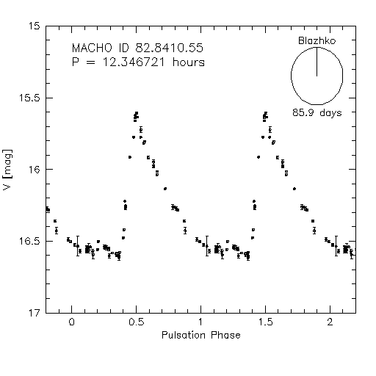
The nature of RR Lyrae stars
Blazhko effect (Blazhko 1907)

Slide 29
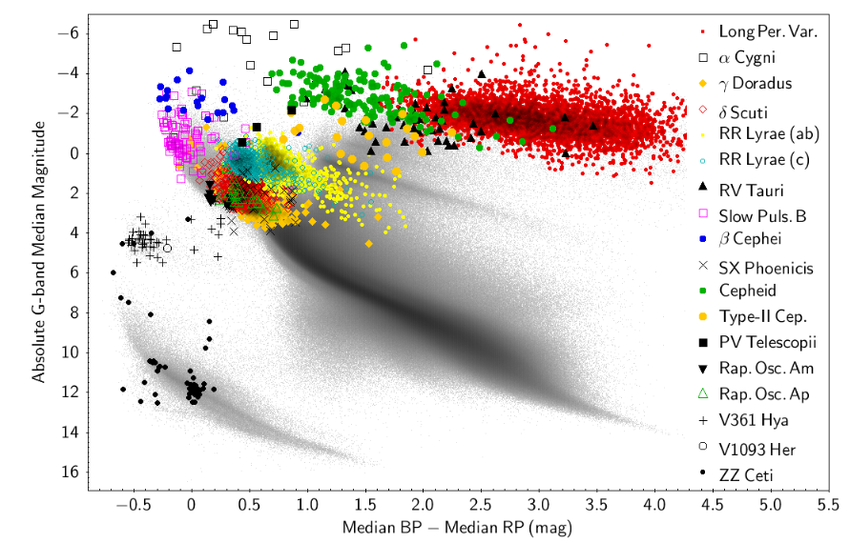
The nature of RR Lyrae stars
Collaboration et al. 2018

Slide 30
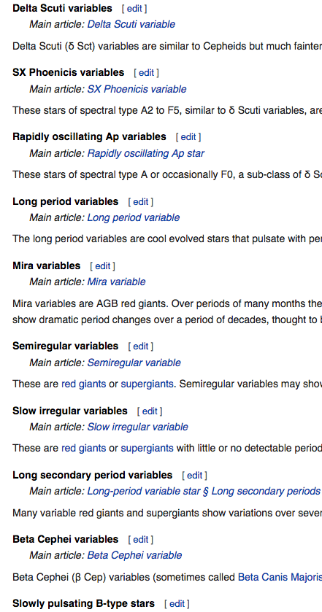
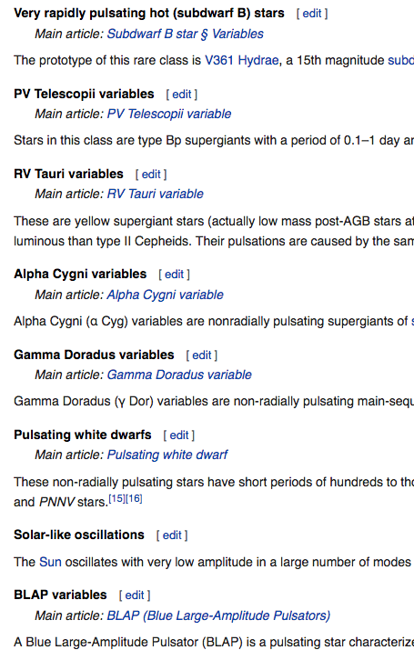
Intrinsic variable star
Pulsating variables: stars whose radius alternately expands and contracts as part of their natural evolutionary ageing process.

Slide 31
Intrinsic variable star
Eruptive variables: stars who experience eruptions on their surfaces like flares or mass ejections.
Wolf–Rayet variables: Wolf–Rayet stars are massive hot stars that sometimes show variability, probably due to several different causes including binary interactions and rotating gas clumps around the star. They exhibit broad emission line spectra with helium, nitrogen, carbon and oxygen lines. Variations in some stars appear to be stochastic while others show multiple periods.
Luminous blue variables: Also known as the S Doradus variables, the most luminous stars known belong to this class. Examples include the hypergiants η Carinae and P Cygni. They have permanent high mass loss, but at intervals of years internal pulsations cause the star to exceed its Eddington limit and the mass loss increases hugely. Visual brightness increases although the overall luminosity is largely unchanged. Giant eruptions observed in a few LBVs do increase the luminosity, so much so that they have been tagged supernova impostors, and may be a different type of event.

Slide 32
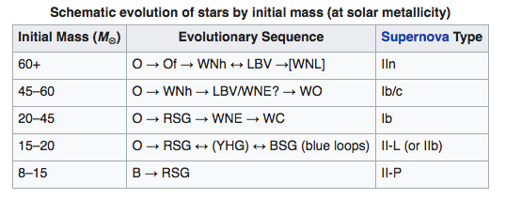
Intrinsic variable star
Eruptive variables: stars who experience eruptions on their surfaces like flares or mass ejections.

Slide 33
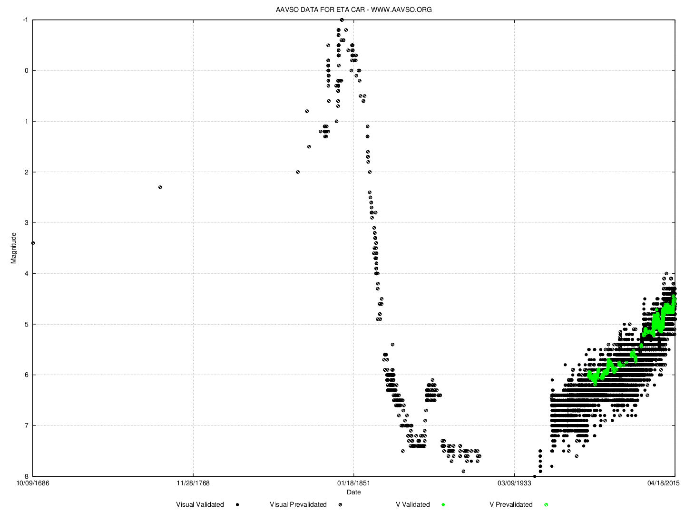
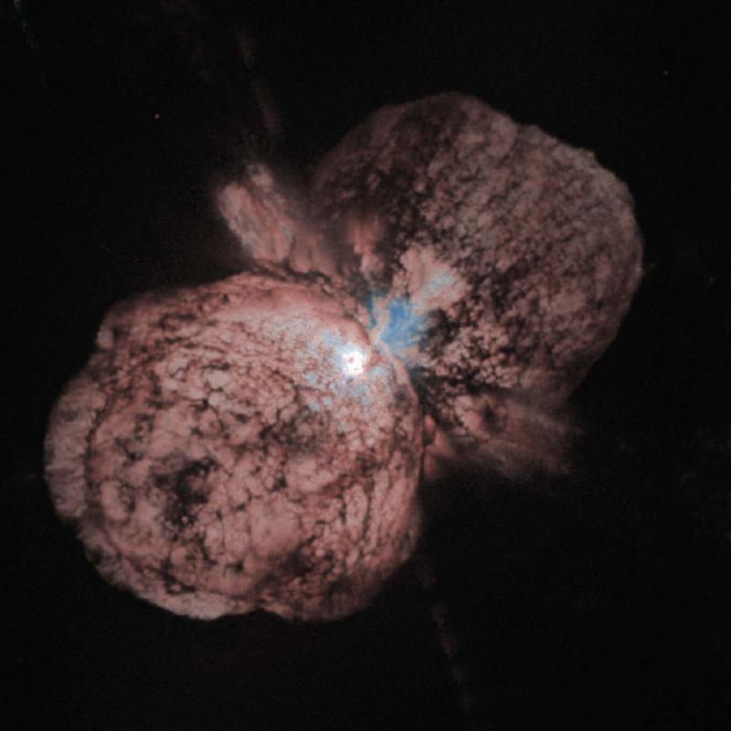
Intrinsic variable star
Eruptive variables: stars who experience eruptions on their surfaces like flares or mass ejections.

Slide 34
Intrinsic variable star
Cataclysmic or explosive variables: stars that undergo a cataclysmic change in their properties like novae and supernovae.

Slide 35
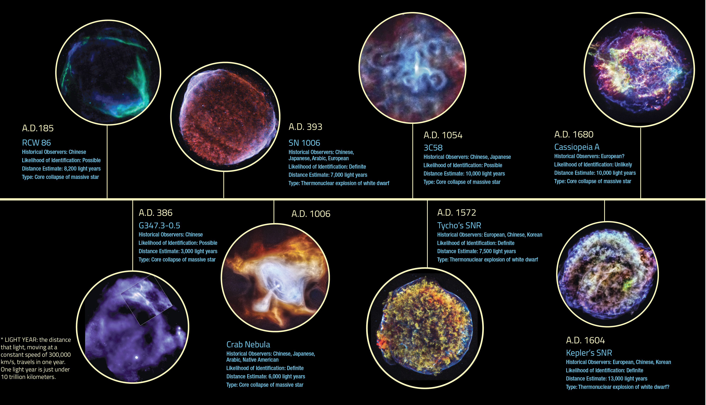
Intrinsic variable star
Cataclysmic or explosive variables: stars that undergo a cataclysmic change in their properties like novae and supernovae.

Slide 36
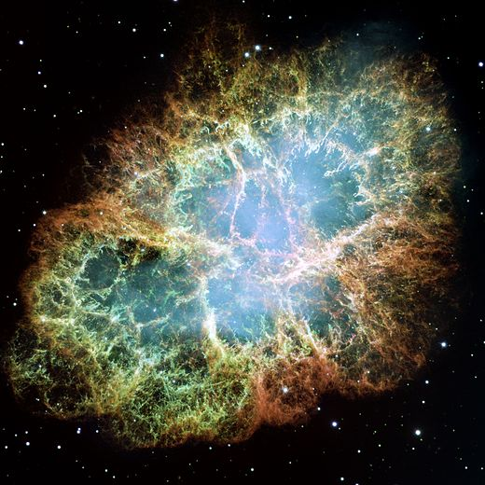
Intrinsic variable star
Crab nebula (M1, NGC 1952, Taurus A)
The Crab nebula was first identified in 1731 by John Bevis.
Also independently rediscovered in 1758 by Charles Messier.
The now-current name is due to William Parsons, 3rd Earl of Rosse, who observed the object in 1840 using a 36-inch telescope and produced a drawing that looked somewhat like a crab.

Slide 37
Intrinsic variable star
Crab nebula (M1, NGC 1952, Taurus A)
The Crab nebula was first identified in 1731 by John Bevis.
Also independently rediscovered in 1758 by Charles Messier.
The now-current name is due to William Parsons, 3rd Earl of Rosse, who observed the object in 1840 using a 36-inch telescope and produced a drawing that looked somewhat like a crab.

Slide 38
Intrinsic variable star
Crab nebula (M1, NGC 1952, Taurus A)

Slide 39
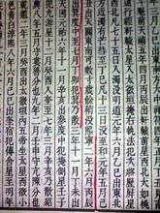
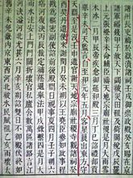
Intrinsic variable star
Crab nebula (M1, NGC 1952, Taurus A)
宋史-天文志，第九 宋史-仁宗本纪

Slide 40
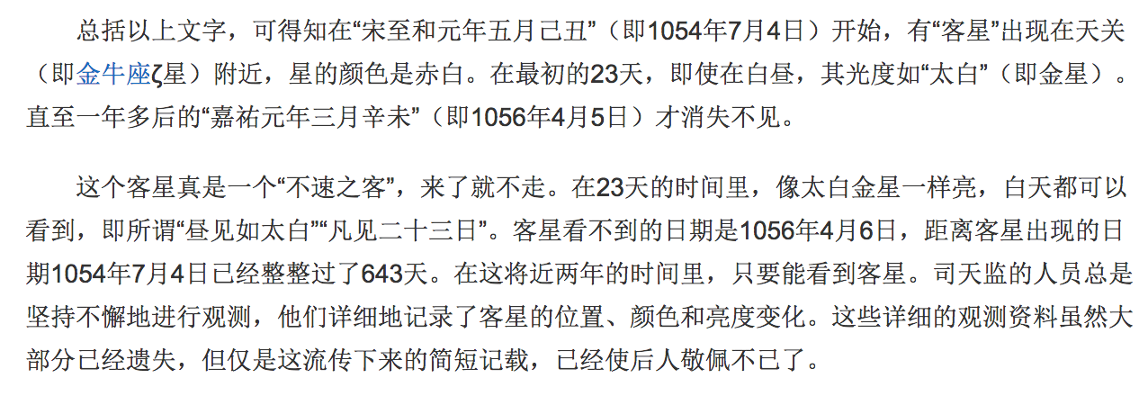
Intrinsic variable star
Crab nebula (M1, NGC 1952, Taurus A)
宋史-天文志，第九 宋史-仁宗本纪

Slide 41
Extrinsic variable star
Extrinsic variable stars: stars where the variability is caused by external properties like rotation or eclipses. There are two main subgroups.
Eclipsing binaries: double stars where, as seen from Earth's vantage point the stars occasionally eclipse one another as they orbit.
Rotating variables: stars whose variability is caused by phenomena related to their rotation. Examples are stars with extreme "sunspots" which affect the apparent brightness or stars that have fast rotation speeds causing them to become ellipsoidal in shape.

Slide 42
Binary Types
In our Galaxy, more than half of the stars are binary or multiple systems. They can be generally divided into groups from an observational view:
Visual binaries: stars whose radius alternately expands and contracts as part of their natural evolutionary ageing process.
Astrometric binaries: Only one star visible (other too dim). Infer existence of unseen companion causing oscillatory motion of the visible star.
Spectroscopic variables: Period is sufficiently short to cause observable periodic shift of spectral lines (if vr≠0). Very useful when they also eclipse.

Slide 43
Visual Binaries

Slide 44
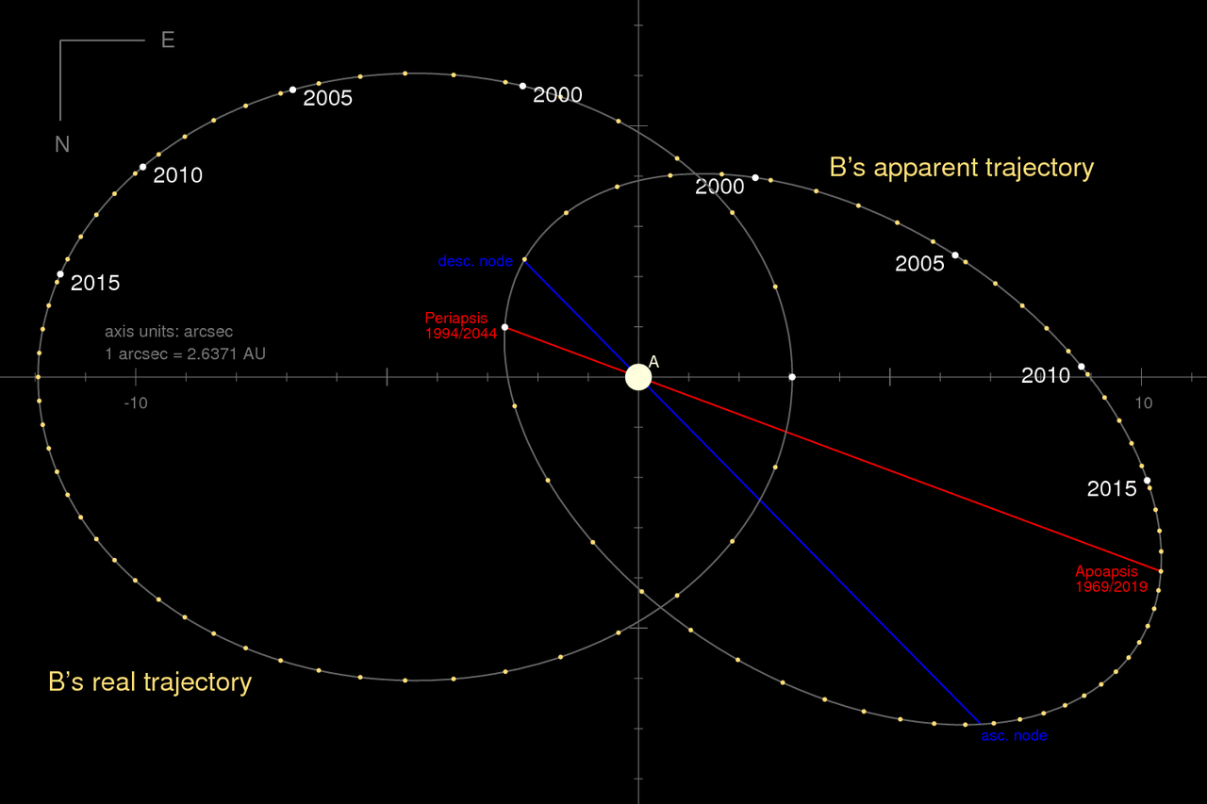
Visual Binaries

Slide 45
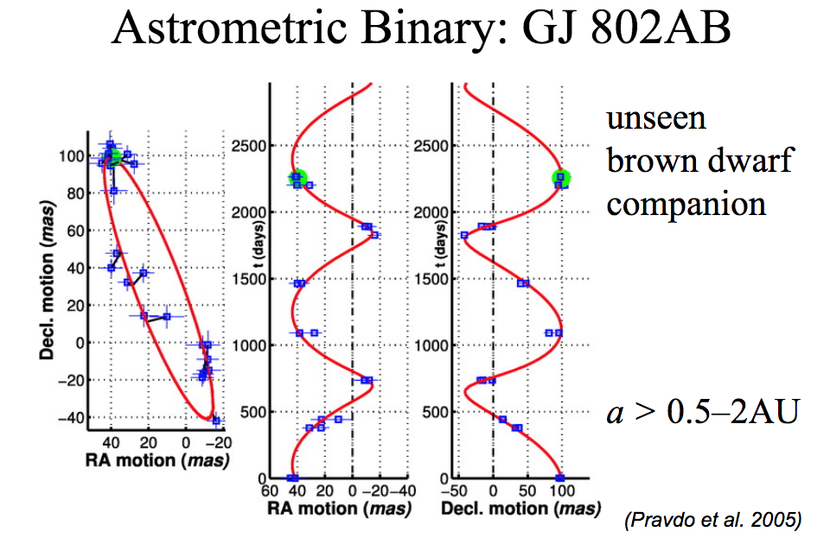
Astrometric Binaries

Slide 46
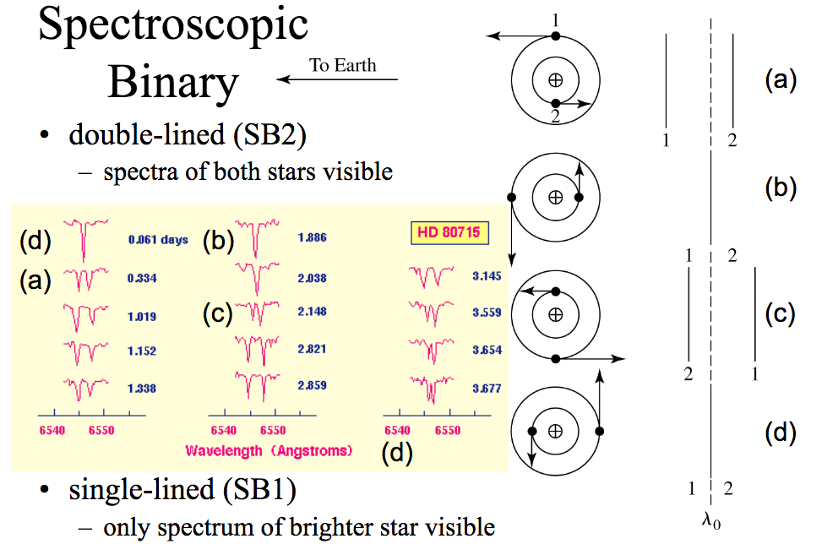
Spectroscopic Binaries

Slide 47
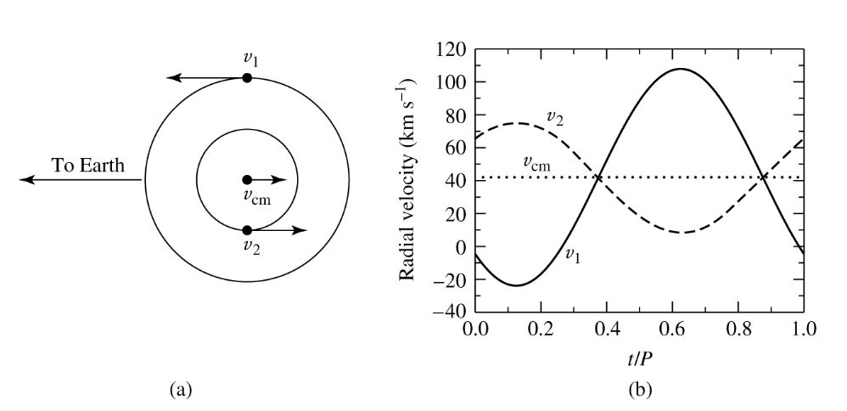
Spectroscopic Binaries

Slide 48
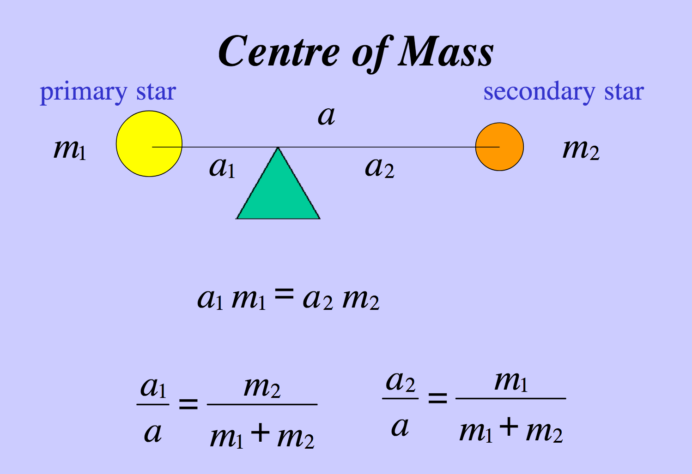
Fundamentals from binaries

Slide 49
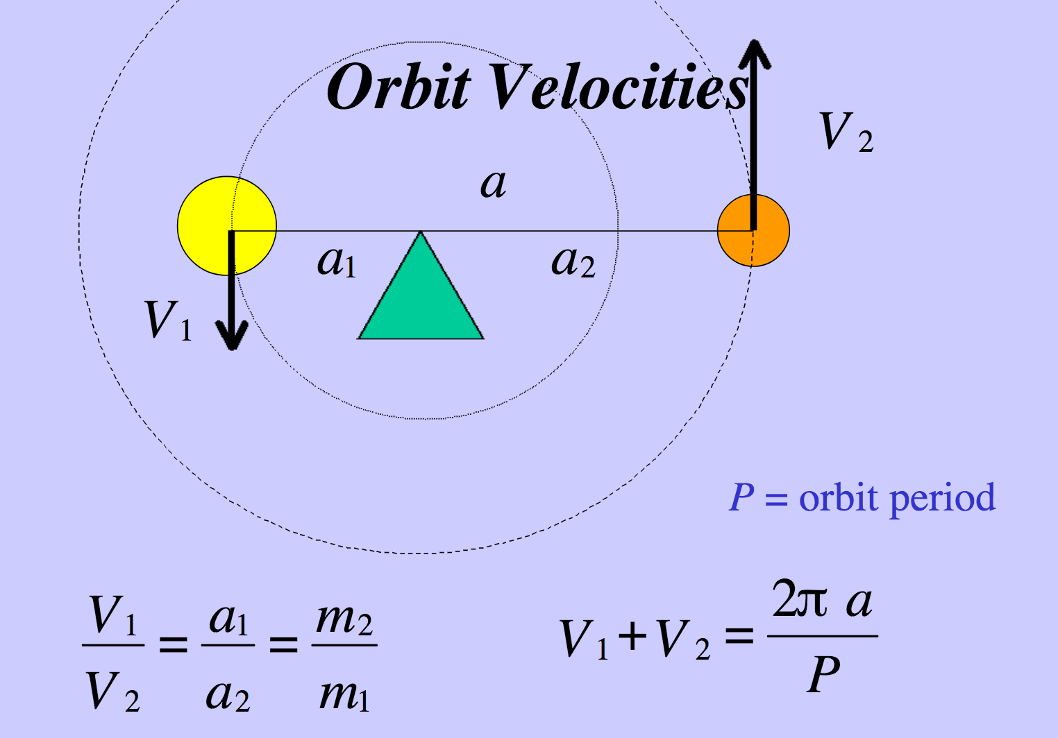
Fundamentals from binaries

Slide 50
Fundamentals from binaries

Slide 51
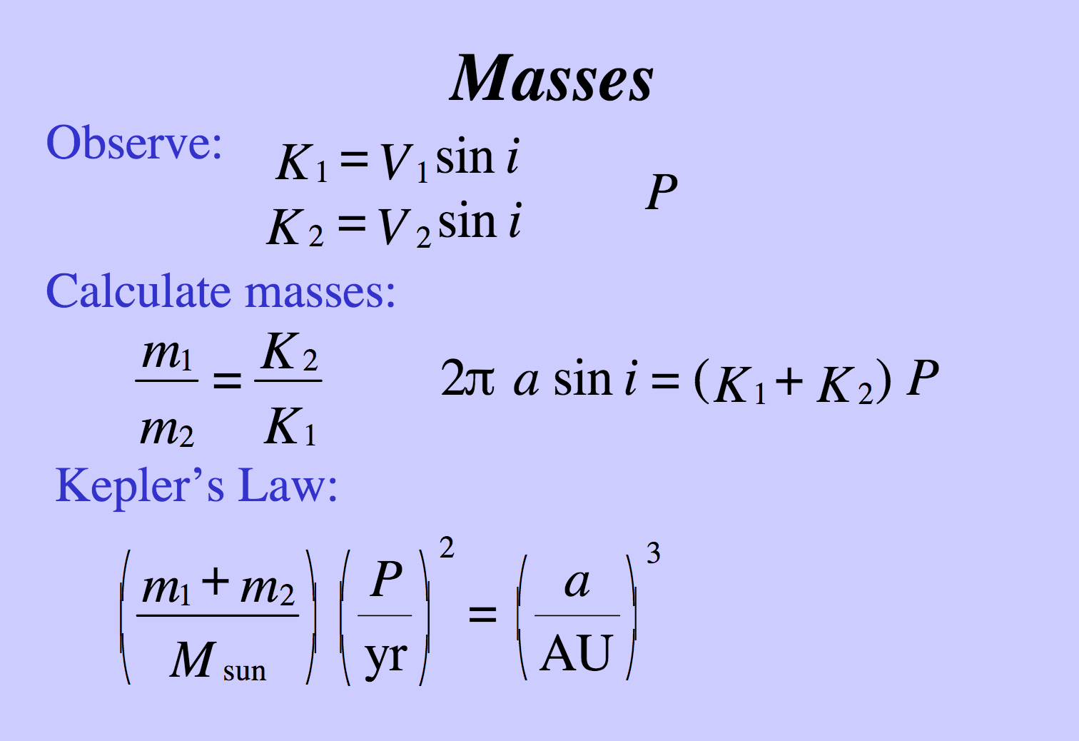
Fundamentals from binaries

